Slide 1
Alaska Studies
Geography Vocabulary Assignment Part 1

Slide 2
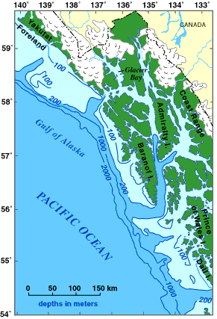
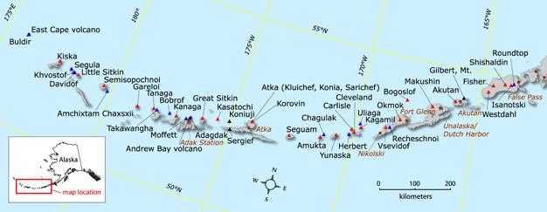
Archipelago
a group of islands and the water containing the islands
Alexander Archipelago in SE Alaska
Aleutian Islands in SW Alaska

Slide 3
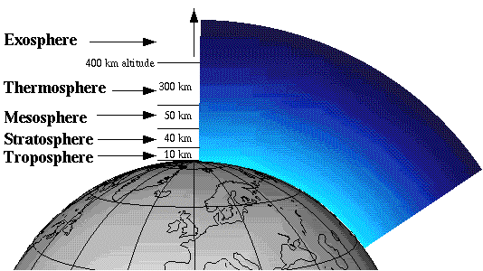
Atmosphere
The envelope of gases surrounding the earth or another planet

Slide 4
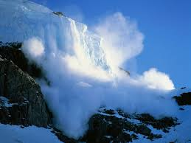
Avalanche
A mass of snow, ice, and rocks falling rapidly down a mountainside
http://video.nationalgeographic.com/video/101-videos/avalanches?source=relatedvideo

Slide 5
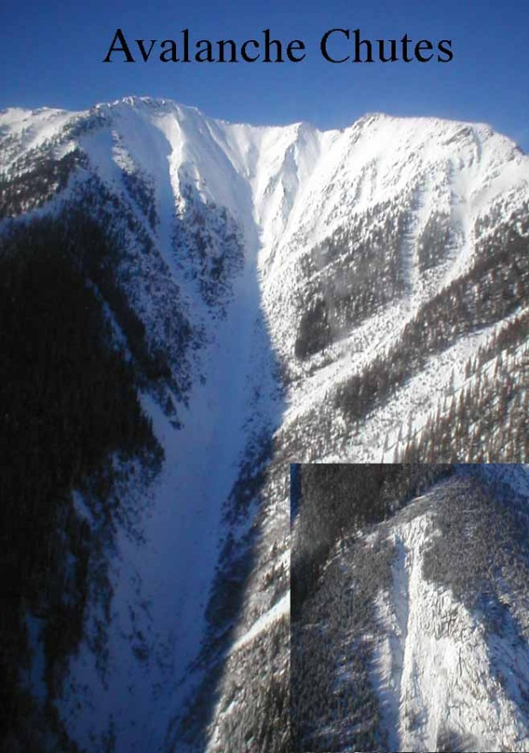
Avalanche Chute
An avalanche chute is a natural channel down a steep mountain slope, the path followed by an avalanche’s tumultuous racing snow and debris

Slide 6
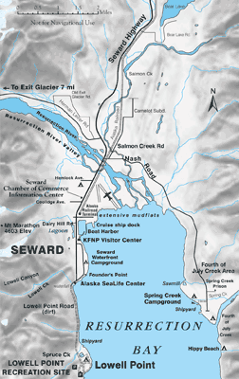
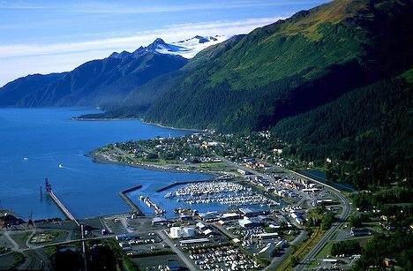
Bay
a broad inlet of the sea where the land curves inward
Resurrection Bay, Seward Peninsula

Slide 7
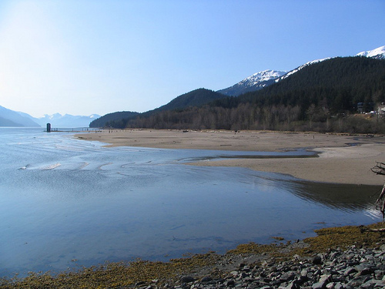
Beach
A pebbly or sandy shore, especially by the ocean between high- and low-water marks

Slide 8
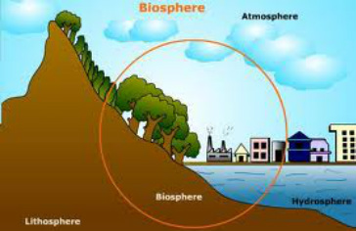
Biosphere
The regions of the surface, atmosphere, and hydrosphere of the earth (or of other planets) occupied by living organisms; the zone of life

Slide 9
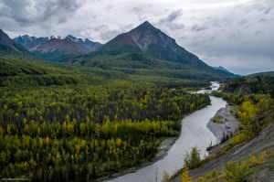
Boreal forest
The forests found in the circumpolar regions of the world including Alaska's interior are known as Boreal Forests or “Taiga”
These forests extend from the Kenai Peninsula to the Tanana Valley near Fairbanks, and as far north as the foothills of the Brooks Range
They stretch from the Porcupine River near the Canadian border and west down the Kuskokwim River valley
Tree species included: spruce, aspen, birch, balsam poplar, and larch

Slide 10
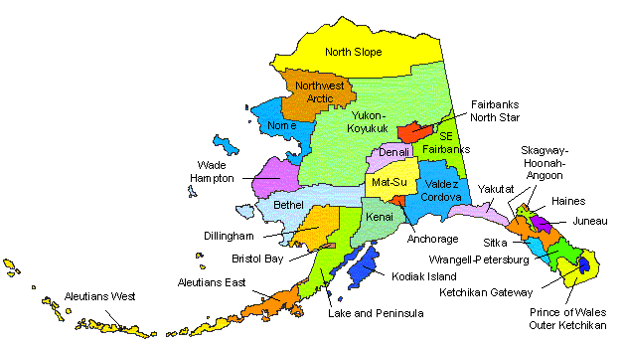
Boundary
A line indicating the limit of a country, state, or other political jurisdiction

Slide 11
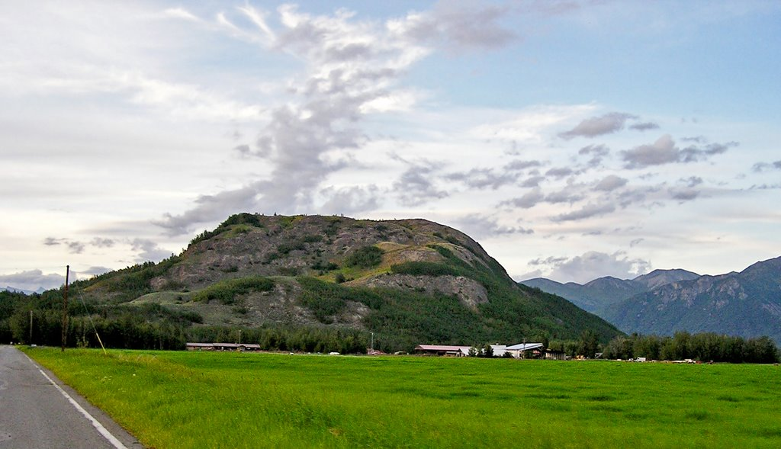
Butte
An isolated hill or mountain with steep sides and a flat summit area

Slide 12
Cartographer
A person who draws or makes maps or charts

Slide 13
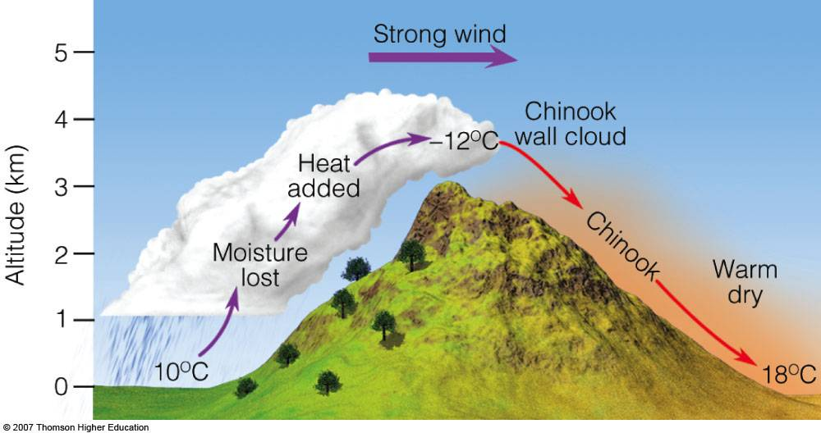
Chinook wind
A warm, dry wind experienced along the eastern (or northern side of mountain ranges in Alaska)
Most common in winter and spring, it can result in a rise in temperature of 35 to 40 °F in a quarter of an hour
https://www.youtube.com/watch?v=VEJmQglWnQY

Slide 14
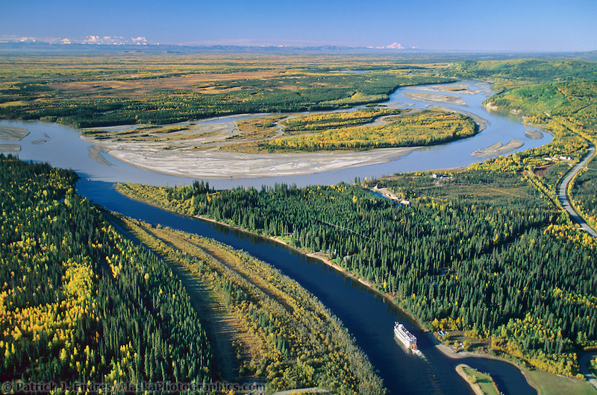
Confluence
The place at which two streams (or rivers) flow together to form one larger stream

Slide 15
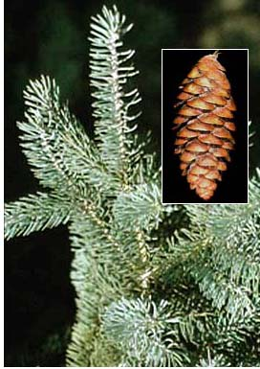
Coniferous
Bearing cones; from the conifer family; trees that bear cones
Characteristics include:
cones (instead of fruit)
needles (instead of leaves)
evergreen (they keep their needles year round instead of losing their leaves in the fall)

Slide 16
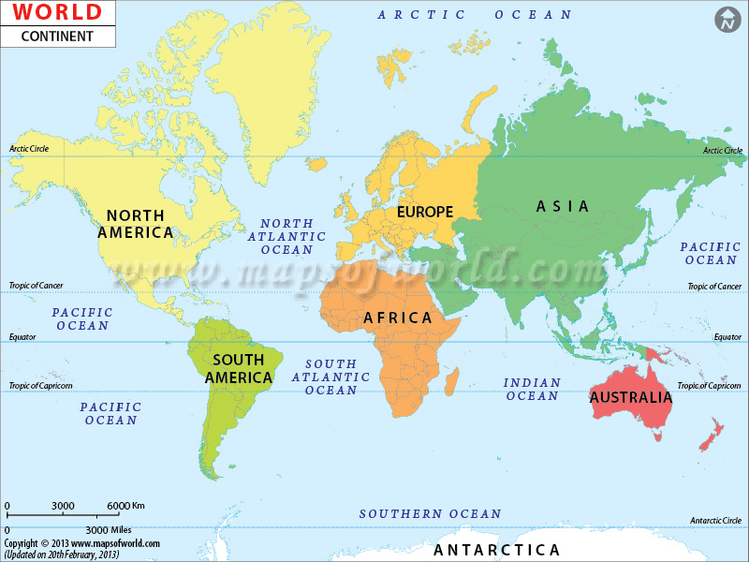
Continent
One of the large, continuous areas of the Earth into which the land surface is divided
https://www.youtube.com/watch?v=QL7LX5-ytOg

Slide 17
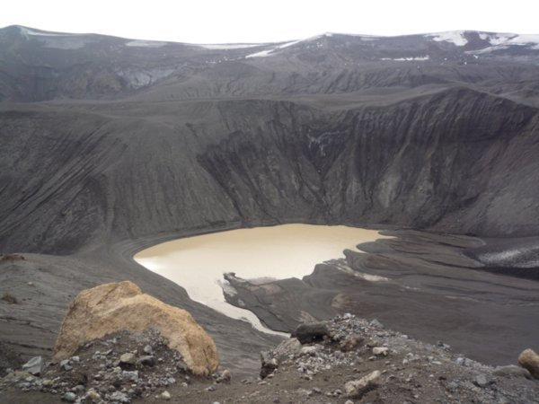
Crater
The circular depression (sometimes) containing a volcanic vent

Slide 18
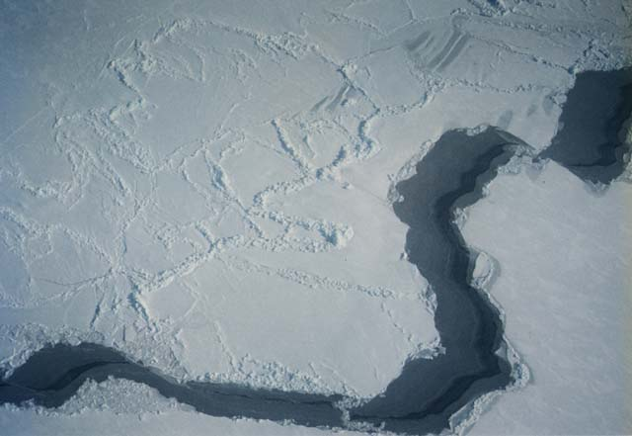
Cryosphere
The ice and snow on the Earth's surface, such as glaciers; sea, lake, and river ice; snow; and permafrost

Slide 19
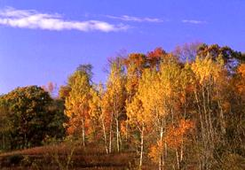
Deciduous
Trees that lose their leaves each year

Slide 20
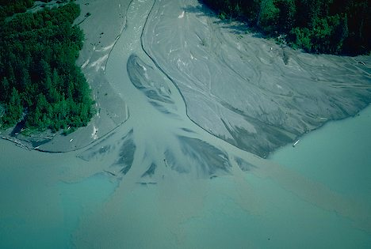
Delta
A land form that is formed at the mouth of a river where the mainstream splits up into several distributaries. It is formed from the deposition of the sediment carried by the river as the flow leaves the mouth of the river

Slide 21
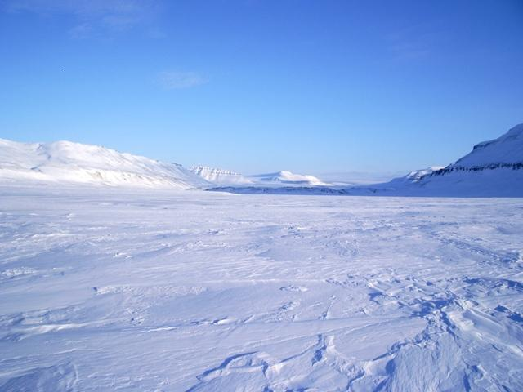
Desert
A barren area of land where little precipitation occurs (usually less than 10 inches per year)and consequently living conditions are hostile for plant and animal life

