Slide 1
Geography Vocabulary #3
Terms 41-60

Slide 2
Plate Tectonics
Plate tectonics is the theory that Earth's outer shell is divided into several plates that glide over the mantle, the rocky inner layer above the core
Divergent—pull apart
Convergent—come together
Mountains, volcanoes, landslides and tsunamis
Transformative—slide against
https://www.youtube.com/watch?v=1-HwPR_4mP4

Slide 3
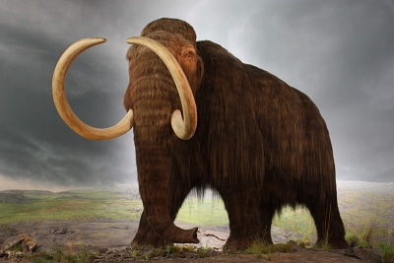
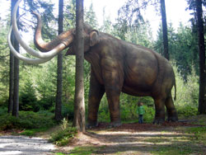
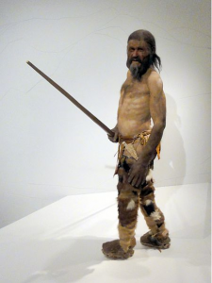
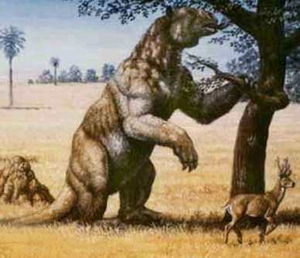
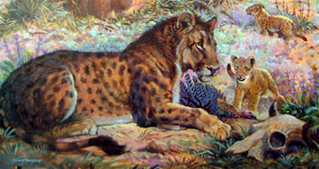
Pleistocene (Epoch)
The Pleistocene Epoch is typically defined as the time period that began about 1.8 million years ago and lasted until about 11,700 years ago. The most recent Ice Age occurred then, as glaciers covered huge parts of the planet Earth

Slide 4
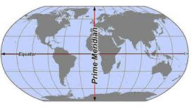
Prime Meridian
The earth's zero of longitude, which by convention passes through Greenwich, England. Divides the earth into the Eastern and Western Hemispheres
The modern prime meridian, based at the Royal Observatory, Greenwich, was established by Sir George Airy in 1851

Slide 5
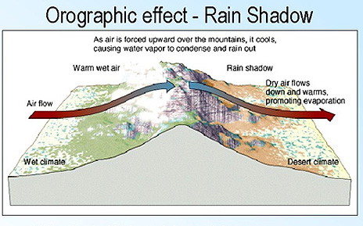
Rain Shadow
A region having little rainfall because it is sheltered from prevailing rain-bearing winds by a range of mountains

Slide 6
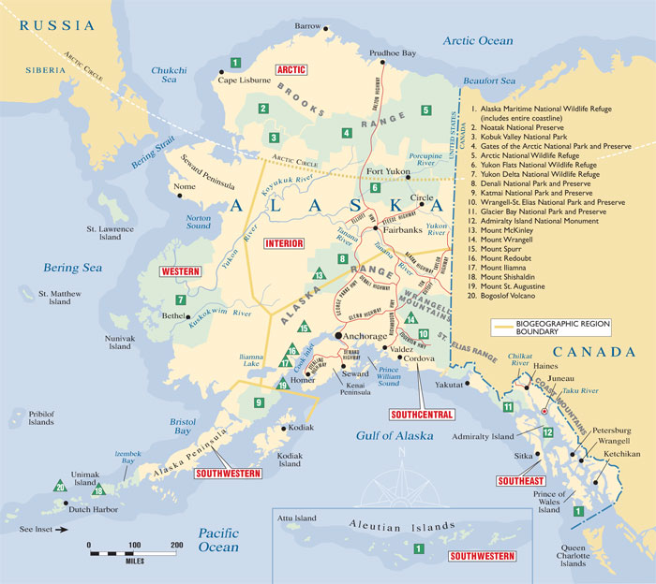
Region
An area or division having definable characteristics but not always fixed boundaries

Slide 7
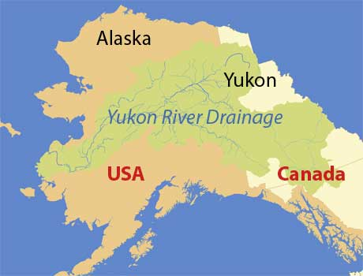
River
A large natural stream of water flowing in a channel to the sea, a lake, or another such stream
Yukon River, 1,400 miles in Alaska and 580 in Canada, is the fourth largest river in the United States
Porcupine River, 555 miles
Koyukuk River, 554 miles
Kuskokwim River, 540 miles
Tanana River, 531 miles
Innoko River, 463 miles
Colville River, 428 miles

Slide 8
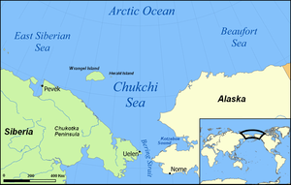
Sea
A large body of water that is part of the ocean or that has land around part or all of it

Slide 9
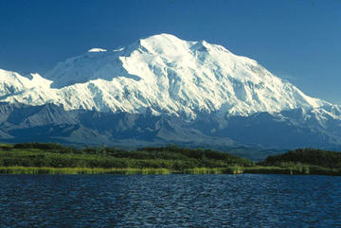
Snowline
The altitude above which some snow remains on the ground in a particular place throughout the year

Slide 10
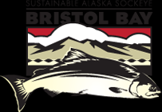
Sustainable Yield
The amount of any resource that can be harvested without harming the yield of that resource from year to year

Slide 11
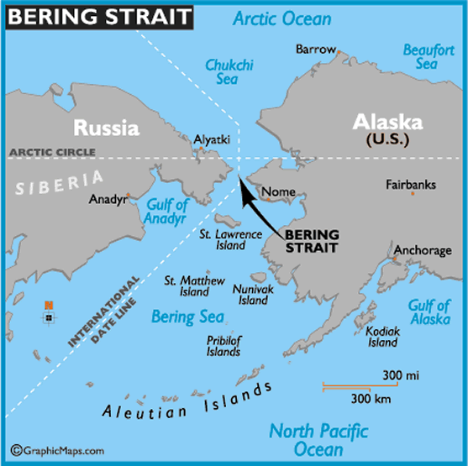
Strait
A narrow passage of water connecting two seas or two large areas of water

Slide 12
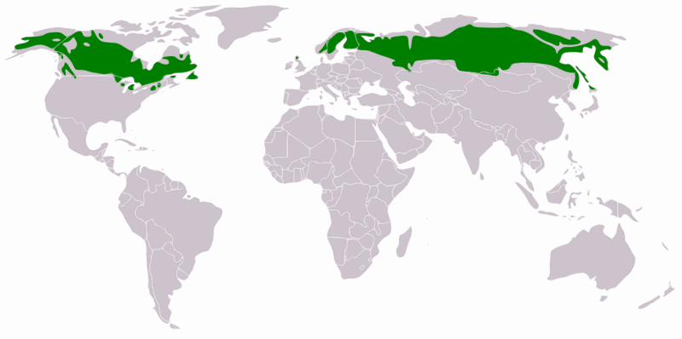
Taiga
The sometimes swampy coniferous forest of high northern latitudes, especially that between the tundra and steppes of Siberia and North America
See Boreal Forest

Slide 13
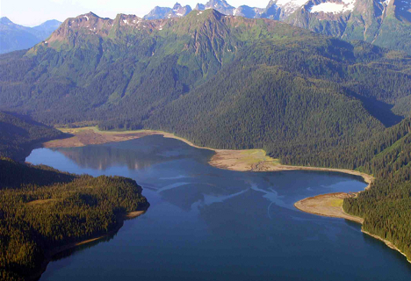
Temperate Rainforest
Temperate rainforests are found on the western edge of North and South America, where moist air from the Pacific Ocean drops between 60 and 200 inches of rain a year
Unlike the tropical rain forest, the temperate rain forest has seasonal variation, with summer temperatures rising to about 80 degrees Fahrenheit and winter temperatures dropping to near freezing. In the northernmost regions, winter may be cold enough for some ice and snow

Slide 14
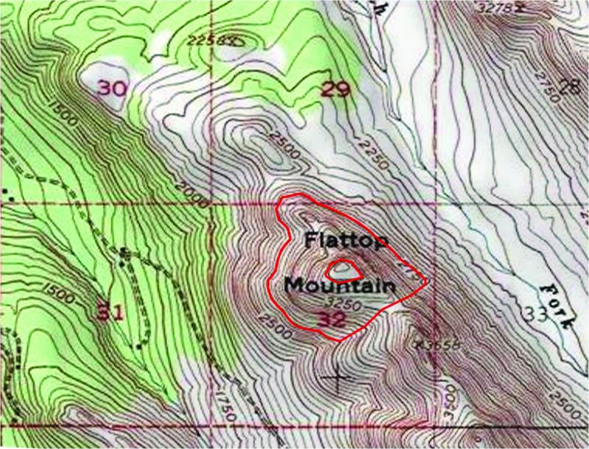
Topographical Map
A type of map characterized by large-scale detail and representation of relief, using contour lines

Slide 15
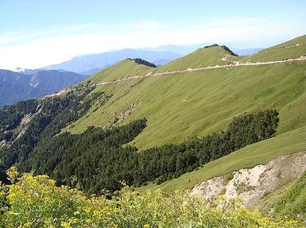
Tree Line
On a mountain, the line or altitude above which no trees grow

Slide 16
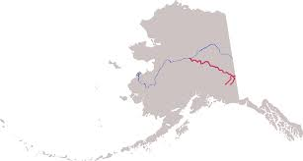
Tributary
A river or stream flowing into a larger river or lake
Course of the Tanana River, formed by the shorter Nabesna River (left) and Chisana River (right), then flowing northwest to meet the Yukon River

Slide 17
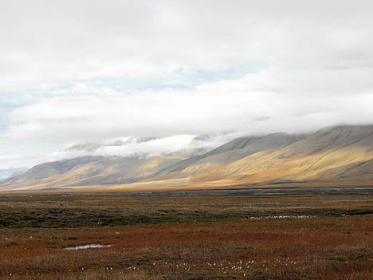
Tundra
A vast, flat, treeless Arctic region of Europe, Asia, and North America in which the subsoil is permanently frozen

Slide 18
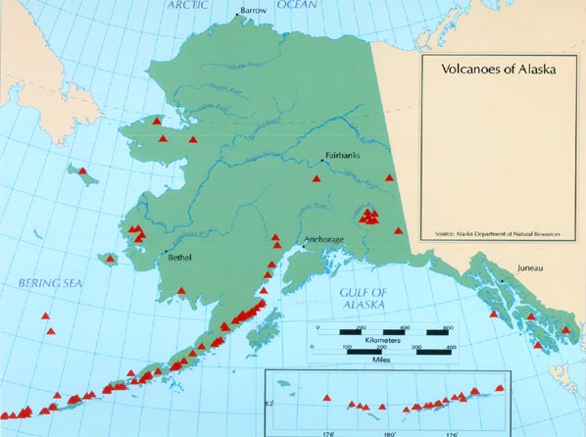
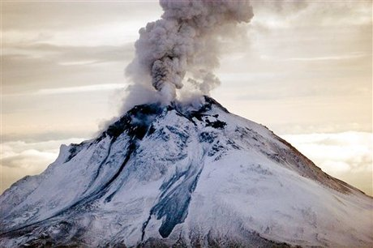
Volcan0
A mountain or hill having a crater or vent through which lava, rock fragments, hot vapor, and gas are being or have been erupted from the earth's crust

Slide 19
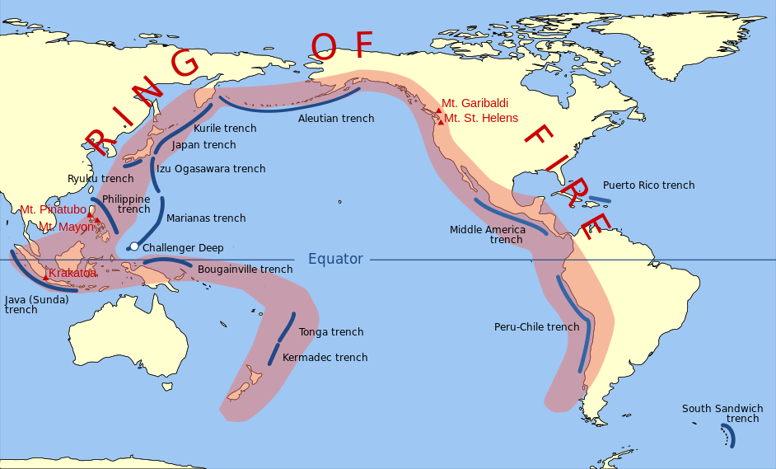
Ring of Fire goes along with Volcano
The Ring of Fire is an area where a large number of earthquakes and volcanic eruptions occur in the basin of the Pacific Ocean
http://www.history.com/shows/how-the-earth-was-made/videos/how-the-earth-was-made-ring-of-fire

Slide 20
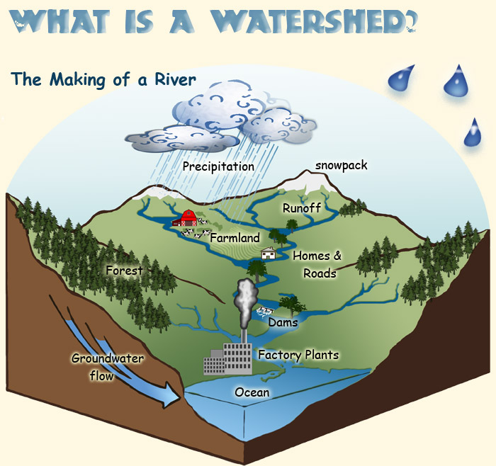
Watershed Area
An area or ridge of land that separates waters flowing to different rivers, basins, or seas

Slide 21
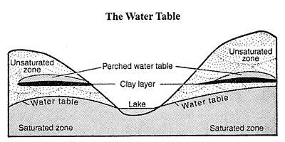
Water Table
The level below which the ground is saturated with water

Slide 22
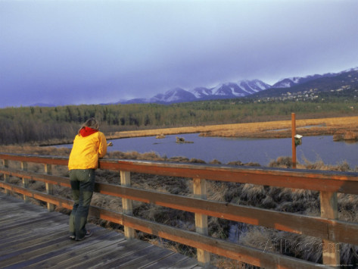
Wetland
Land consisting of marshes or swamps; saturated land
Marsh, bog, swamp muskeg slough

