Slide 1
Geographic Regions of Alaska
6 Regions
http://www.alaskakids.org/index.cfm/Know-Alaska/Alaska-Geography/Regions/

Slide 2
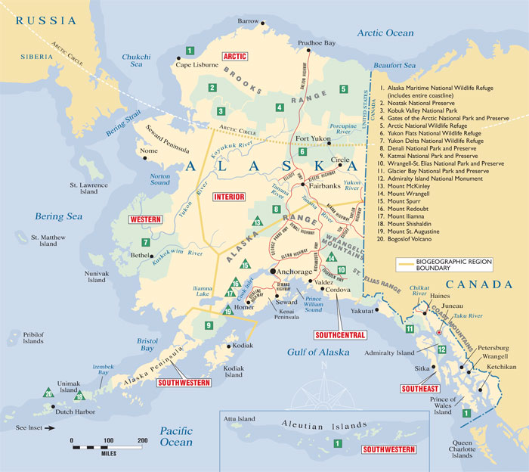
Map
http://infoaboutalaska.com/environment/six-states-of-alaska/
http://www.alaskakids.org/index.cfm/know-alaska/Alaska-Geography/Regions

Slide 3
Southeast Alaska
Region 1—Southeast Alaska is the region that looks like it should be in Canada. It is often called Alaska's Panhandle. You can see that if you think of the rest of Alaska as a pan and the long and narrow Southeast Alaska region as the handle. It runs 500 miles along the northern Inside Passage. This waterway snakes through a maze of islands offshore from the mainland of Southeast Alaska

Slide 4
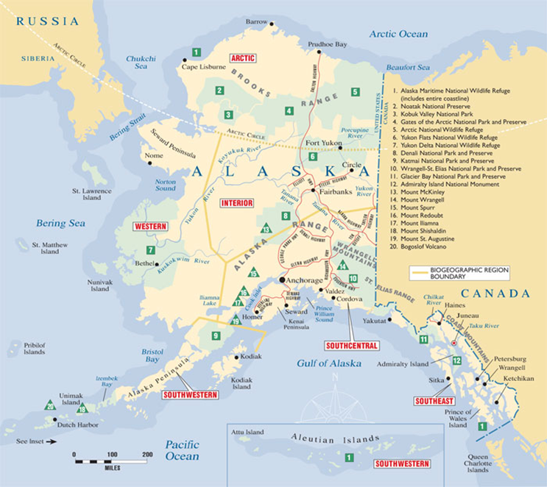
Southcentral Alaska
Region 2—Southcentral Alaska is bounded by the Gulf of Alaska to the South and the Alaska Range to the north. The Chugach Mountains mark the eastern border. The Aleutian Range forms the western border

Slide 5
Interior Alaska
Region 3—Interior Alaska is the land between the Brooks Range to the north and the Alaska Range to the South. From the border with Canada, this huge region stretches west about two-thirds across the state

Slide 6
Southwestern Alaska
Region 4—Southwestern Alaska includes the Alaska Peninsula, Kodiak, the Aleutian Islands and the Pribilof Islands

Slide 7
Western Alaska
Region 5—Western Alaska extends from the Arctic Circle south to Bristol Bay. The Bering Sea forms the western border

Slide 8
Arctic Alaska
Region 6—Arctic Alaska spans the northern edge of the state. It stretches from the Canadian border on the east to the Chukchi Sea to the west. The Brooks Range (the Arctic Circle) forms the southern border. The Arctic Ocean marks the region's northern edge

Slide 9
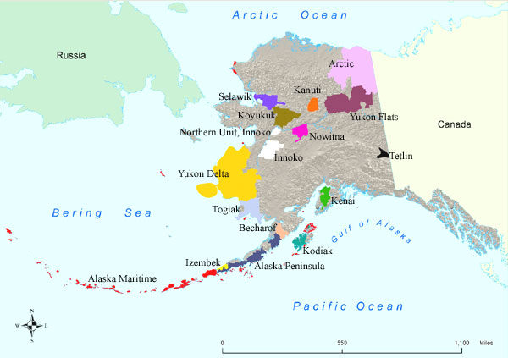
Alaska’s National Wildlife Refuges
16 Total Wildlife Refuges
Alaska Maritime
Izembek
Alaska Peninsula
Becharof
Kodiak
Togiak
Yukon Delta
Innoko
Nowitna
Koyukuk
Selawik
Kanuti
Yukon Flats
Arctic National
Tetlin
Kenai
https://www.youtube.com/watch?v=Z19rGB_DVs8
http://www.fws.gov/alaska/nwr/map.htm

Slide 10
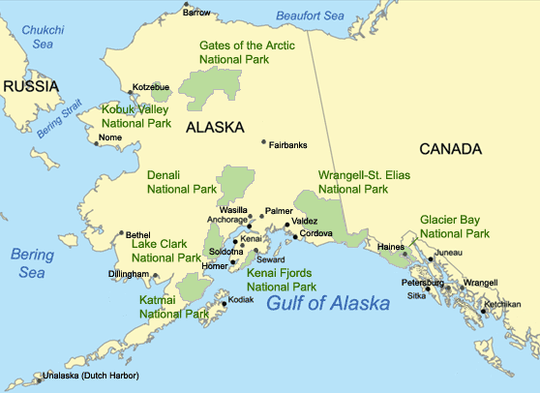
Alaska’s National Parks
8 total
Denali National Park Gates of the Arctic National Park Glacier Bay National Park Katmai National Park Kenai Fjords National Park Kobuk Valley National Park Lake Clark National Park Wrangell-St. Elias National Park

