Slide 1
Maps of Alaska
Mapping Activity
6 Regions of Alaska

Slide 2
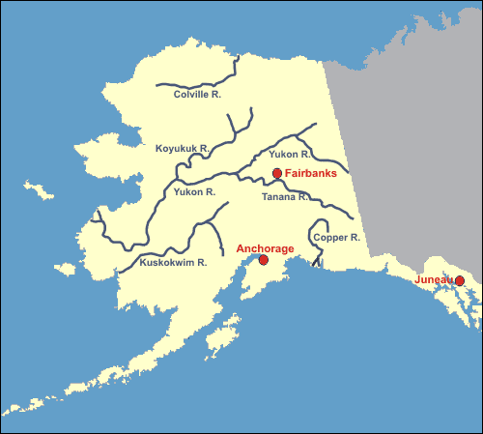
Rivers of Alaska
http://www.treasure-hunt.alaska.edu/ch4/info_rivers.html

Slide 3
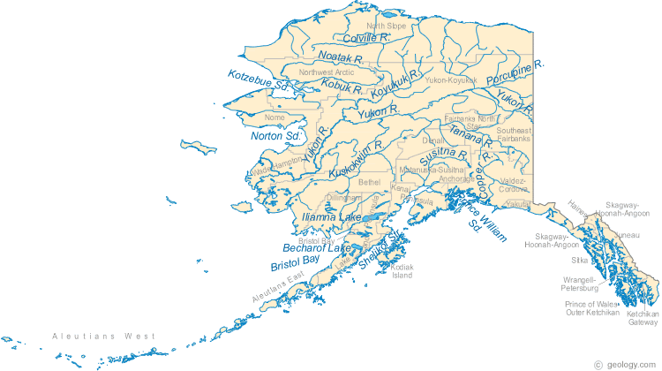
Lakes, Rivers, Streams, cont.
http://geology.com/lakes-rivers-water/alaska.shtml

Slide 4
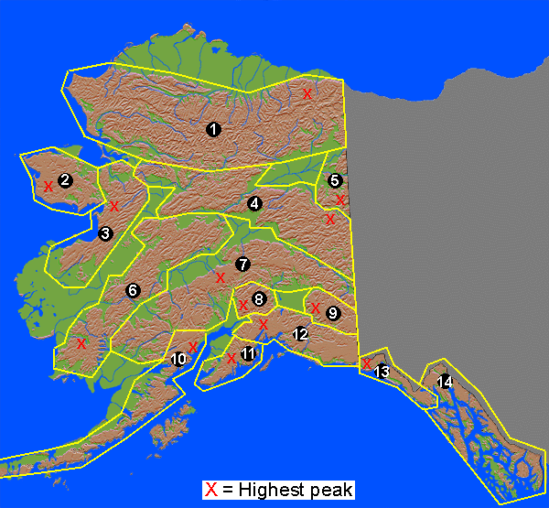
Mountains of Alaska
http://www.greatlandofalaska.com/reference/ranges.html

Slide 5
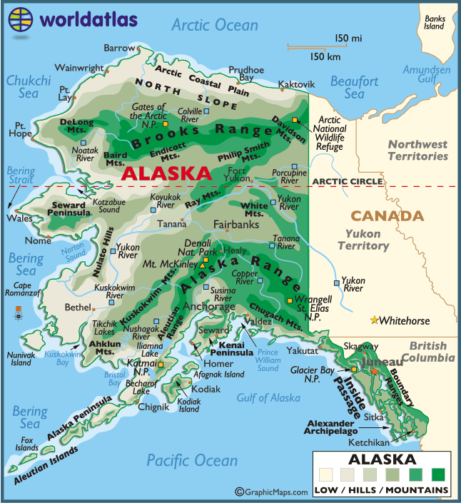
Geography of Alaska
http://www.worldatlas.com/webimage/countrys/namerica/usstates/lgcolor/akcolor.gif

Slide 6
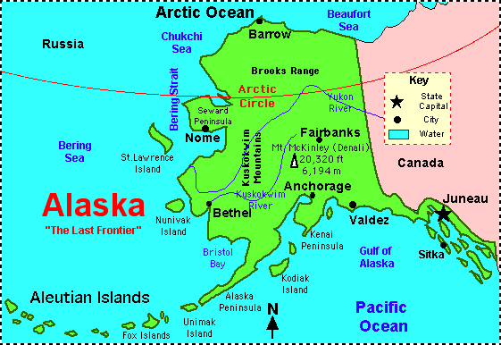
Arctic Circle
http://www.enchantedlearning.com/usa/states/alaska/map.GIF

Slide 7
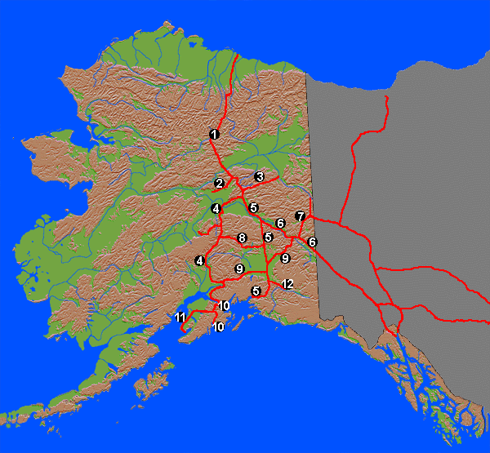
Alaska Highway System
http://www.greatlandofalaska.com/reference/highways.html

Slide 8
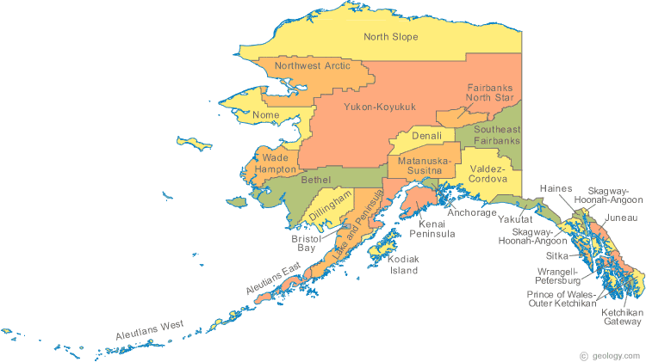
Boroughs of Alaska
http://geology.com/county-map/alaska.shtml

Slide 9
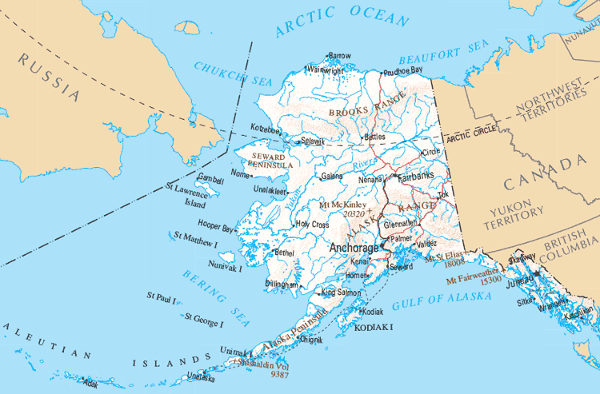
Cities and Towns of Alaska
http://www.citytowninfo.com/images/state-maps/alaska-reference.gif

