Slide 1
The Anglo-Saxons 449-1066
A Brief History

Slide 2
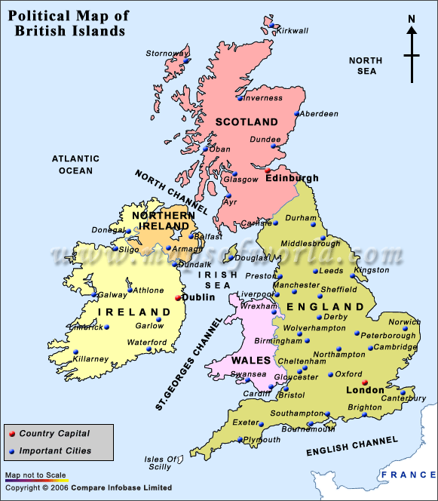
British Isles
The term British Isles includes the United Kingdom and Ireland—England, Scotland, Wales, Northern Ireland, Ireland
Isolated from the rest of Europe by the English Channel

Slide 3
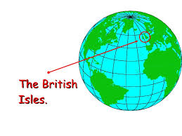
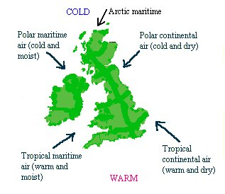
Climate
Maritime climate much like Seattle or even Anchorage
Rainy, foggy, grey, but green

Slide 4
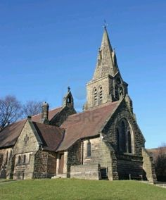
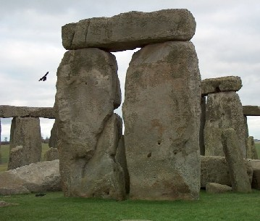
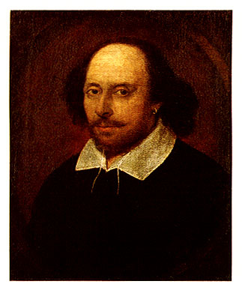
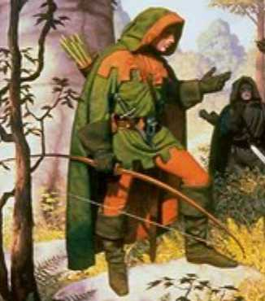
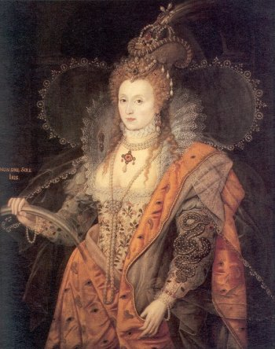
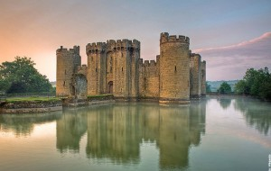
Images of the British Isles

Slide 5
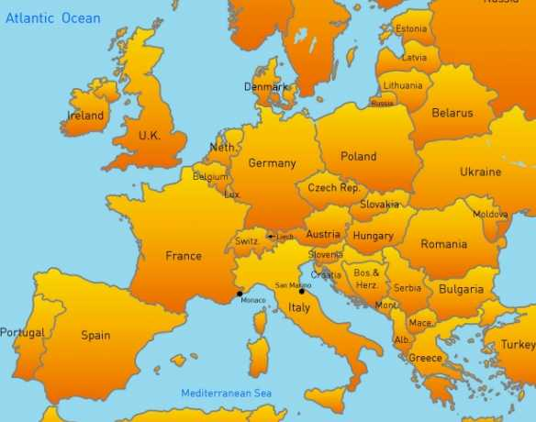
Original Inhabitants of the British Isles
Iberians—from the Iberian Peninsula in present day Portugal and Spain

Slide 6
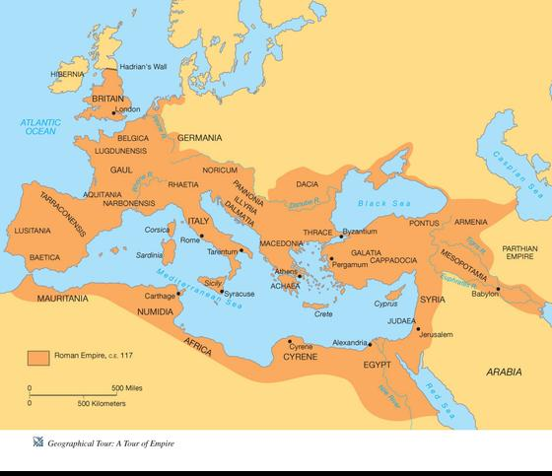
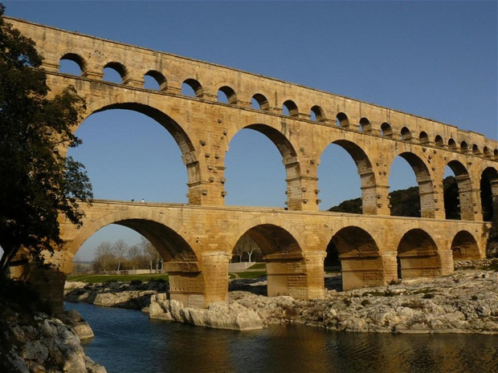
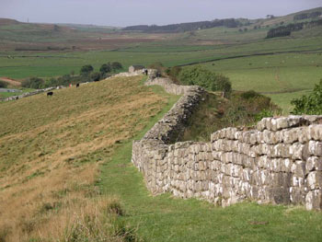
Roman Occupation 55 BCE-409 CE
Arrived with Julius Caesar and remained for over 400 years
Roads
Hadrian’s Wall
Viaducts
Bridges

Slide 7
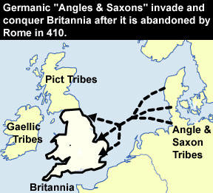
Anglo-Saxon Invasion 449 CE
Angles & Saxons from Germany and the Jutes from Denmark pushed the Britons back (think white settlers and Native American Indians) and imposed their culture on them
Tight-knit communities
Religion—Germanic Paganism—myths, legends and folklore
Gifted storytellers called “scops”
Celebrated heroes of their culture through poetic songs

Slide 8
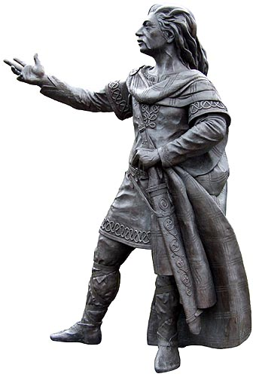
The Spread of Christianity 400-699CE
Christianity was introduced during the Roman occupation, but it didn’t catch on immediately
People of the British Isles were traditionally Druids
5th century, Ireland’s Christian Monks and missionaries sent from Rome by Pope Gregory I and led by Augustine (later St. Augustine of Canterbury) arrived
Welcomed by King Ethelbert of Kent (converted to Christianity)

Slide 9
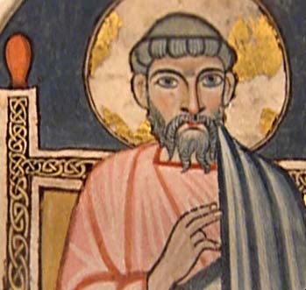
St. Augustine of Canterbury
Augustine of Canterbury was a Benedictine monk who became the first Archbishop of Canterbury in the year 597. He is considered the "Apostle to the English" and a founder of the English Church.
Born: Rome, Italy
Died: May 26, 604 CE, Canterbury, United Kingdom

Slide 10
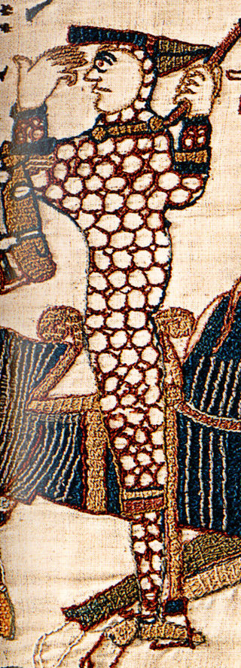
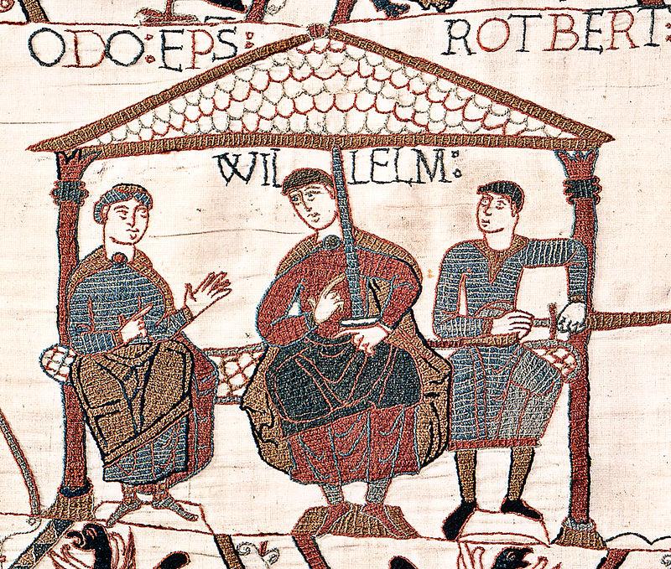
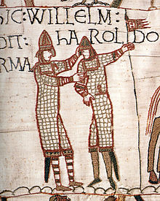
The Norman Invasion 1066 CE
William the Conqueror, Duke of Normandy (French)
Invaded Britain and defeated the Anglo-Saxon armies in the Battle of Hastings
He became the 1st Norman ruler of Great Britain

