Slide 1
The Nome Serum Run
Youtube Links
https://www.youtube.com/watch?v=F_ZbOqFRnxw Iditarod Trail Song by Hobo Jim

Slide 2
Historic Trail

Slide 3
1925 Serum Run
Was a transport of diphtheria antitoxin by dog sled relay across the U.S. territory of Alaska
420 north from Seward to Nenana by train and then relayed
674 miles (1,085 km) from Nenana to Nome
20 mushers and about 150 sled dogs
five and a half days (usually took 25-30 days)
saving the small city of Nome and the surrounding communities from catastrophe
https://www.youtube.com/watch?v=wxz_OWeeiWM 1925 Serum Run documentary, Togo and Balto

Slide 4
The Last Great Race
1964—Wasilla Knik Centennial Committee
1967—100 years since purchase of Alaska from Russia
Dorothy Page, Committee Chair thought of a commemorative race
Joe Redington, wife Vi supported the idea
1967 and 1969—a two-heat, 56 mile sprint race between Knik and Big Lake
Joe Redington wanted MORE—a commemorative running of the original trail
to save the sled dog culture and Alaskan huskies, which were being phased out of existence due to the introduction of snowmobiles in Alaska
and to preserve the historical Iditarod Trail between Seward and Nome
1973-2015
https://www.youtube.com/watch?v=Rmz5xubbVic Joe Redington

Slide 5
Race Trail

Slide 6
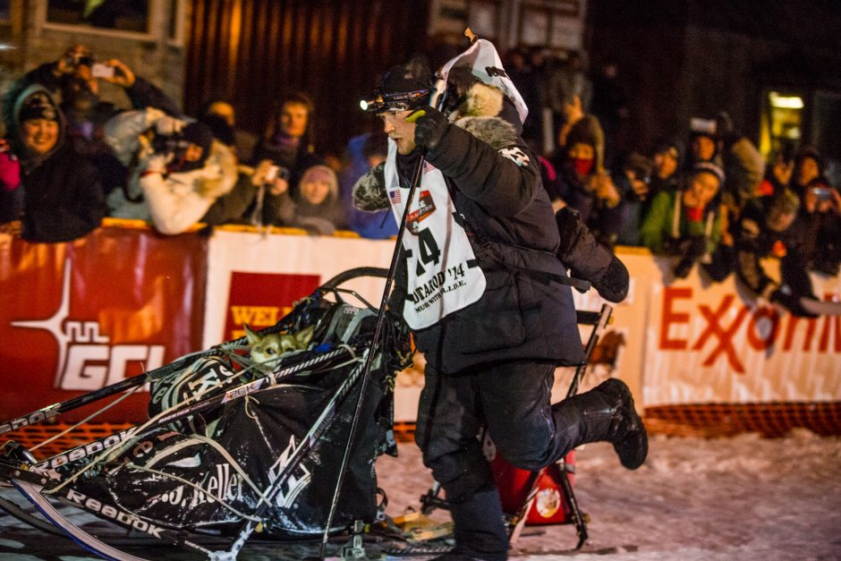
Iditarod
http://iditarod.com/race/2014/ 2014 Race Results
https://www.youtube.com/watch?v=jZvVlo1RIG0 Iditarod Sled Dog Race

