Slide 1
Unit 1, Chapter 1
Section 4
First Encounters

Slide 2
Objectives
Identify the goals of Christopher Columbus
Explain the consequences of his journey to the Americas
Analyze the affects of European contact with the people of the Americas

Slide 3
Terms and People
Bartolomeu Dias Hernan Cortez
Vasco da Gama
Christopher Columbus Moctezuma
John Cabot
Pedro Alvarez Cabral Columbian Exchange
Amerigo Vespucci
Ferdinand Magellan
Conquistador

Slide 4
Why It Matters
With financial backing from Spain’s Monarchs, Columbus found the Americas. He then returned to conquer the land, exploit the wealth, and convert its people to Christianity. The process changed the Americas, Europe, and Africa forever.
Section Focus Question: How did European exploitation affect the Americas?

Slide 5
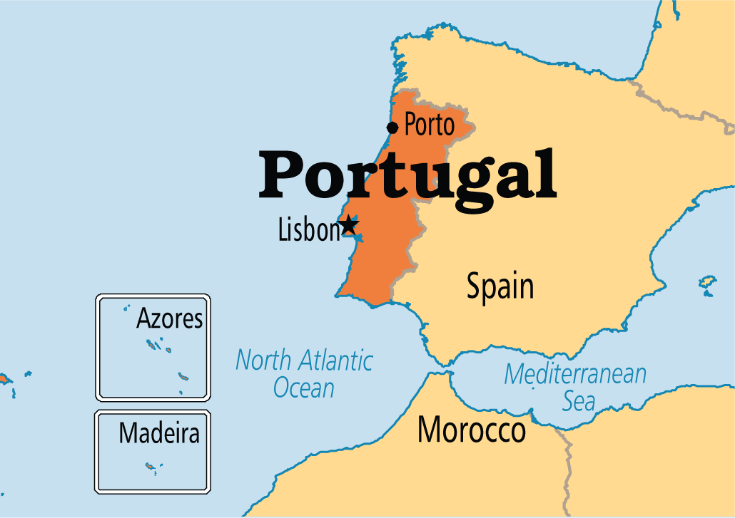
Spain looks to the West
Throughout the 1400s, Portugal led Europe in nautical exploration

Slide 6
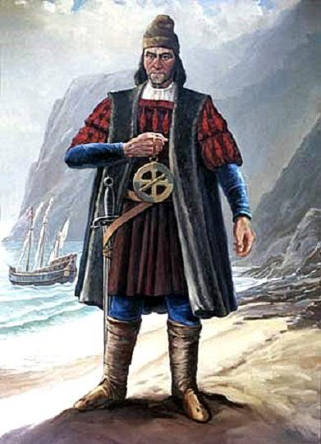
Bartolomeu Dias
In 1487, Dias harnessed the power of the counterclockwise winds of the South Atlantic and sailed around the southern tip of Africa

Slide 7
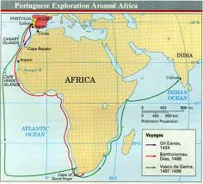
Vasco da Gama
In 1498, da Gama extended Dias’ route and reached India, opening an immensely profitable trade route
The Portuguese dominated the trade routes around Africa

Slide 8
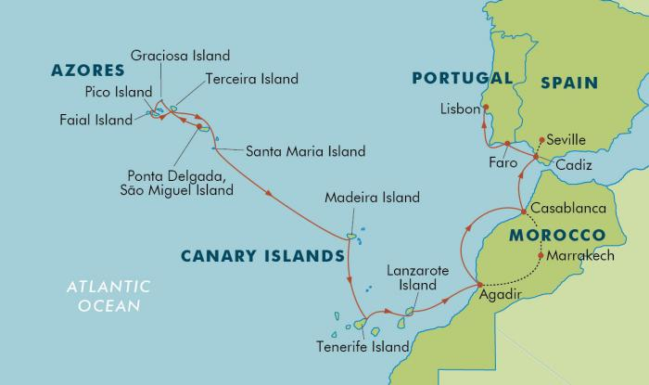
So the Spanish looked…
…Westward across the Atlantic
Earlier, a group of islands had been discovered

Slide 9
China
The Spanish were looking for a western route to China
Marco Polo (Venetian) wrote extensively about his travels to China in the 1200s
Knew the world was round, but feared large expanses of open seas and were uncertain of what lay beyond the islands

Slide 10
The Voyages of Columbus
The Italian mariner from Genoa, Christopher Columbus, was interested in reviving the Christian struggle against Islam. (Remember the Crusades of the late Middle Ages?)
He hoped that by finding a western route to China and converting the Chinese to Christianity, he might recruit them in the struggle.
He underestimated the size of the earth or might not have attempted the voyage

Slide 11
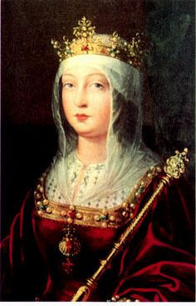
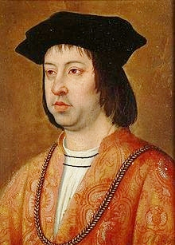
Columbus sets sail
In 1492, Queen Isabella and King Ferdinand of Spain funded his trip

Slide 12
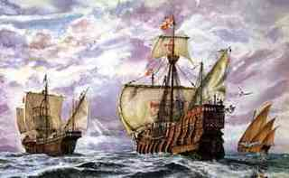
They provided
Three ships: the Nina, the Pinta, and the Santa Maria
90 men
Necessary funding and supplies

Slide 13
On his 1st trip,
He reached the Bahamas, turned south and found what he thought was part of the East Indies, near the Asian mainland. He called the people “Indians.”

Slide 14
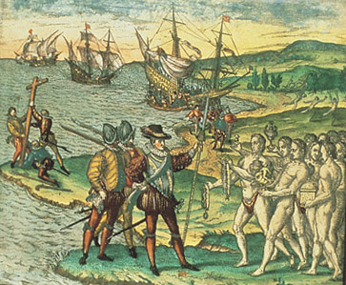
Colonization
Despite the presence of native people, Columbus claimed the land for Spain
As a Christian, Columbus believed he had a RIGHT and a DUTY to dominate the people he found

Slide 15
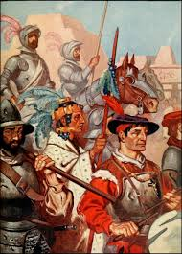
Conquistadors
The conquistadors were professional warriors who conquered territory, opened trade routes and colonized much of the world for Spain and Portugal

Slide 16
The Columbian Exchange
Describes the exchange of plants, animals and diseases between Europe and the Americas
The exchange also included the continents of Africa and Asia. It was a GLOBAL exchange
The impact of the flow of people, products, and ideas had a greater impact on the world than anyone could have imagined

Slide 17
For more information…
Watch the Great Age of Exploration video below
https://www.youtube.com/watch?v=VVD6f20OG9w

Slide 18
Early Colonies in the Americas

