Slide 1
Unit 2—The Revolution
Chapter 4, Section 1—Causes of the revolution

Slide 2
Chapter 4
https://www.youtube.com/watch?v=Eytc9ZaNWyc
Crash Course History—Prelude to Revolution

Slide 3
Section 1
Salutary Neglect—England allowed the colonies local self-rule as long as the colonists supported British economic policies and assisted with wars
Colonists enjoyed the protection of England
Profited by trade with Britain
So…What caused the colonists to rebel against the British?

Slide 4
Colonial governments based on Political Heritage
British Monarchy
Parliament
House of Lords—titled, inherited
House of Commons—elected (<1/4 of men had right to vote)
Colonists were not represented in British Parliament
Colonial Government
Most Colonial Governors appointed by King (Conn. & Rhode Island Elected their Governors)
Most had a Two-house legislature
Upper House—Appointed by governor (prominent colonists, not titled)
every colony except Pennsylvania; Pennsylvania the entire assembly was elected
Lower House—Elected by men who held land (2/3) of men had right to vote

Slide 5
Differences in colonial governments
British constitution based on centuries of tradition
Colonists’ right spelled out in legal documents
Royal Charters of Maryland and S. Carolina
Mayflower Compact
< ¼ of British men owned property and had the right to vote
2/3 of free colonial men
By 1776, challenges in Europe had allowed elected colonial assemblies to increase power
Weakening the position of appointed governors
Assemblies often held salaries of unpopular governors

Slide 6
What caused the colonists to rebel?
Money Issues
French and Indian War
Salaries
1764 The Sugar Act--a law passed by the British Parliament in 1764raising duties on foreign refined sugar imported by the colonies so as to give British sugar growers in the West Indies a monopoly on the colonial market
Early 1765 The Quartering Act--The Quartering Act of 1765 required the colonies to house British soldiers in barracks provided by the colonies
March 1765 The Stamp Act--an act of the British Parliament for raising revenue in the American Colonies by requiring the use of stamps and stamped paper for official documents, commercial writings, and various articles: it was to go into effect on November 1, 1765, but met with intense opposition and was repealed in March,1766
Taxation w/o representation

Slide 7
Resistance
Three forms of Resistance
Intellectual Resistance
John Adams
John Locke
Patrick Henry
Violent Resistance
Patriots—those colonists who opposed British taxes
Sons of Liberty
Sam Adams
Economic Resistance
Boycotts
Daughters of Liberty
Home made goods

Slide 8
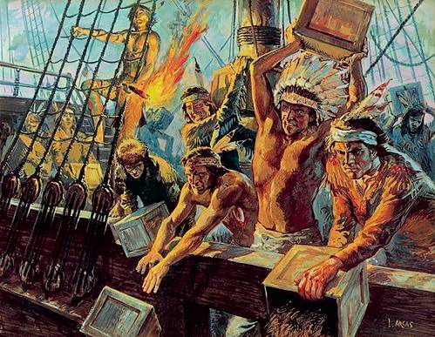
Stamp Act Repealed 1766
But, Parliament passed a law making it legal to tax the colonists
1767 The Townsend Act
The Townshend Acts imposed duties on everyday items imported into the Colonies like: glass, lead, paints, paper and tea
Violence erupted
The Boston Massacre
The Boston Tea Party

Slide 9
British Reaction
The Coercive Acts--a series of British measures passed in 1774 and designed to punish the Massachusetts colonists for the Boston Tea Party
Closed Boston Harbor
Strengthened power of appointed governors; reduced power of elected colonial assemblies
Sent British warships and troops to Boston
Forced colonists to house British troops
Allowed British officials to be tried in England for crimes committed in the colonies
Colonists called them the “Intolerable Acts”

Slide 10
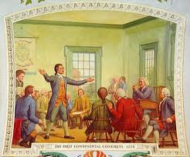
1st Continental Congress
Fall 1774, Philadelphia, PA
Delegates from every colony EXCEPT Georgia
Boycotts of all British imports

Slide 11
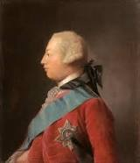
John Adams
By 1774, John Adams had decided that he lived in America and that made him American, not British
He advocated unification of the colonies to defeat the British
Most colonists still considered themselves British subjects
Most hoped that Parliament would lift the Coercive Acts and grant representation of colonists in Parliament
Most believed that when petitioned, King George would side with them against Parliament
They were wrong

