Slide 1
Chapter 4, Section 2 & 3
Declaring Independence and
Turning Points of the War

Slide 2
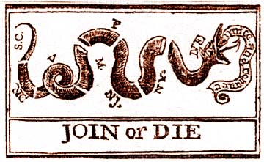
Why it matters
Beating the British “super-power” was a BIG challenge
  Pop. Of Britain 4x that of the colonies
  20% of colonials were Loyalists
  20% of colonials were slaves
  Others remained neutral for as long as possible
http://www.foundingfathers.info/stories/gadsden.html

Slide 3
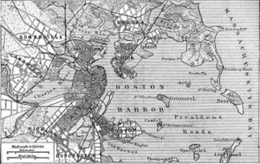
Opposing Sides
Patriots had a cause worth fighting for—Liberty
    British soldiers were there to fight because they were told to
The British underestimated the Patriots as an enemy

Slide 4
Britain vs. Colonials strengths and weaknesses
Nearly 10 million people in Britain
Manufacturing Kings
  Ships
  Weapons
  Supplies
Established Government
Established Army and Navy
Established Economy
2.5 million people in 13 colonies
Farming
  Few ships
  Few military grade weapons
  Limited supplies
New Government
Militia
Growing Economy

Slide 5
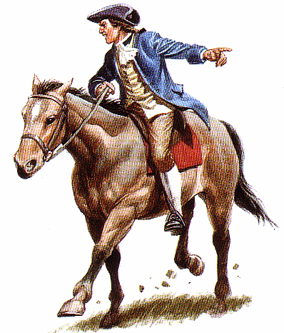
Battles prior to 1777
April 1775
Battles of Lexington and Concord—two country towns west of Boston
  Gage provoked the battles by
    Sending troops to arrest Adams and Hancock in Lexington
    And to seize Patriot weapons in Concord
    Tipped off by Paul Revere, the Patriot militia drove the British troops back to Boston
    More than 200 Redcoats killed or injured

Slide 6
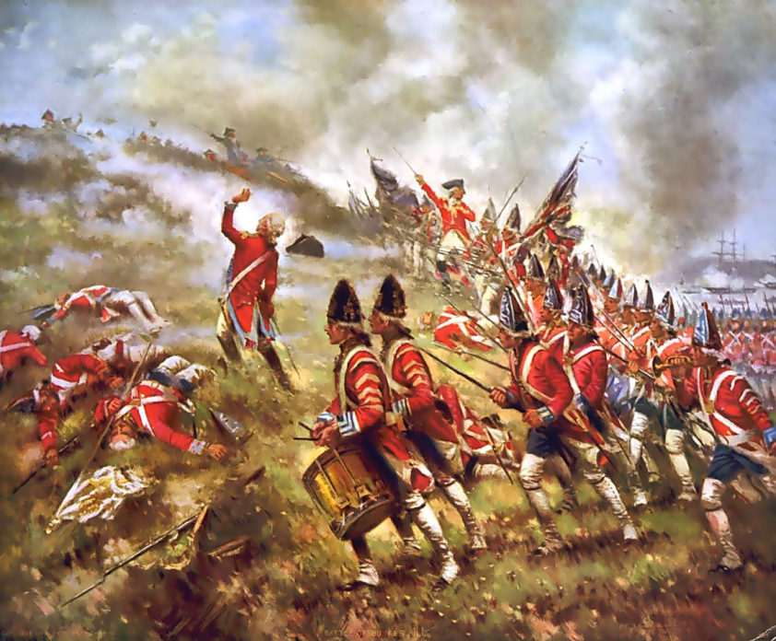
Battles cont.
Two months after the defeat at Concord, the Battle of Bunker Hill
  (British) Lord William Howe made several mistakes:
    Frontal attack
    Middle of the day
    Wearing red uniforms
    He underestimated the enemy
Technically, British won
  Patriots ran out of ammunition
  British suffered twice the casualties
In March 1776, the British abandoned Boston

Slide 7
Hard times
British naval blockades of ports
  Goods scarce
    Black market, exorbitant prices for simple goods
  Patriots issued paper money
    Decreased value of money
    Risky. If Patriots lost, money worthless
    British paid for goods in gold
Assistance and Support of women essential to the success of the Continental Army

Slide 8
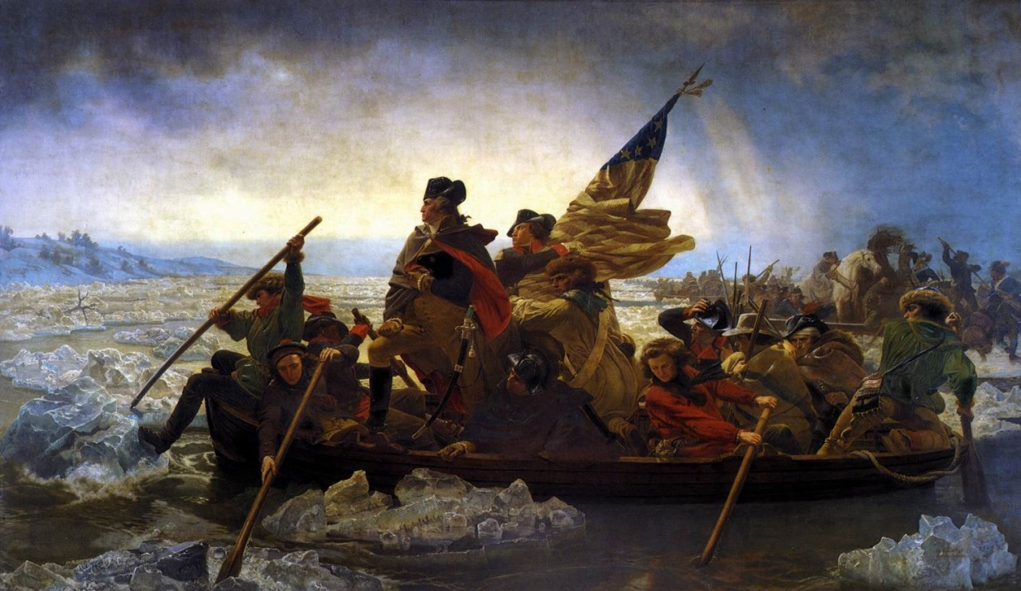
Battles cont.
Battle of Trenton
  Howe captured NYC in Sept. 1776
  Patriots forced to retreat across the Delaware River to New Jersey
  Christmas night, Washington crossed the Delaware back into NY and surprised a group of 1000 German mercenaries
  This modest victory saved the spirits of the Patriots and won support for independence

Slide 9
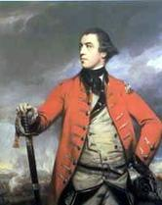
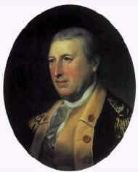
Battles cont.
Battle of Saratoga—the turning point!
  British troops marched from Canada to NY’s Hudson Valley
  Patriot trap awaited in Saratoga
  General John Burgoyne surrendered in Oct. 1777
  This defeat convinced many that the Patriots might just have what it takes to win
General John Burgoyne, British
General Horatio Gates, Patriots

Slide 10
Foreign involvement
France- Allied with Americans
  Supplied men, equipment, money, and ships
  Deal brokered by Benjamin Franklin
Spain- Allied with French
  Wanted to weaken Britain
  Provided money and supplies to patriots
  Prevented British ships from entering Mississippi
German Mercenaries- Allied with British
  Guns for hire

Slide 11
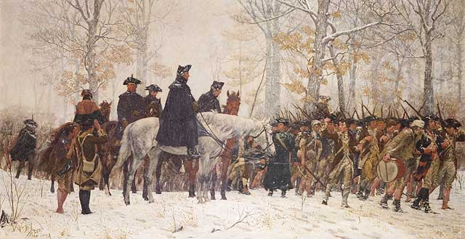
Valley Forge, Pennsylvania
Washington’s troops spent a harsh and hungry winter 1777-1778
  Lacked basic supplies
    Food
    Clothing
    Shoes
German volunteer, Baron Von Steuben trained the troops
  They improved as soldiers
June 1778, British abandoned Philly
British maintained their headquarters in NYC, but little more

Slide 12
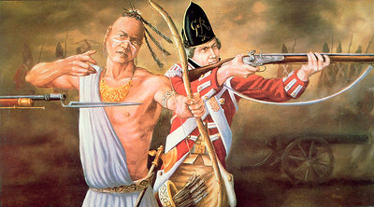
War in the frontier
Most Native Americans supported the British
  Defying the Proclamation of 1763, colonists had begun to settle west of the Appalachian Mts.
  British promised to keep colonists in the East
    1777 Natives increased attacks on settlements
    So, settlers increased attacks on neutral Natives
    Settlers burnt Native villages, which caused Native retaliation and a cycle of retaliation began
    During the winter of 1779 Patriot forces convinced Natives to leave their British allies and retook forts and claimed the Ohio River Valley
    Many settlers returned East

