Slide 1
American Revolution
Chapter 4, Section 4—War’s End and Lasting Effects

Slide 2
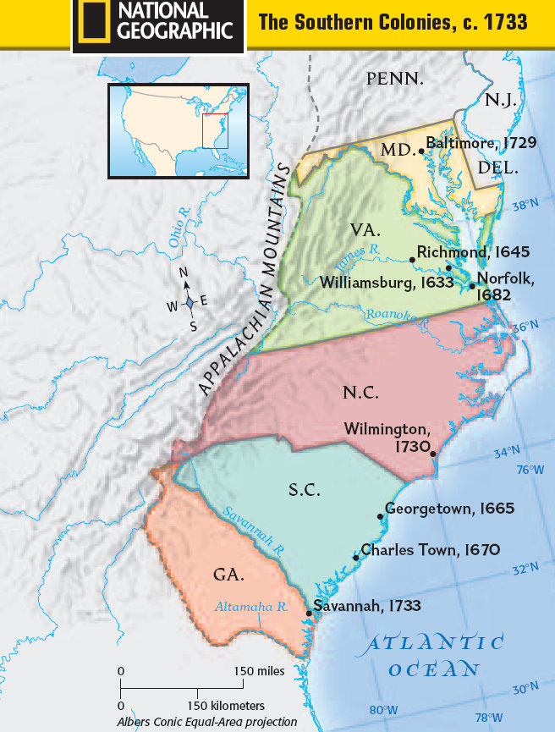
War in the South
In the South, as in the North, the British won most of the battles
1778—British seized Savannah Georgia
Spring 1780—Charleston, SC

Slide 3
War in the South
Spain on the offensive
1780—took Mobile, Al
1781—Pensacola, FL
Intention was to solidify THEIR (Spanish) power in North America
Also, to divert British attention away from the Patriots

Slide 4
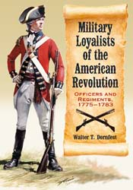
British Error
Expected Loyalist support in the South
Failed to support the Loyalist militias

Slide 5
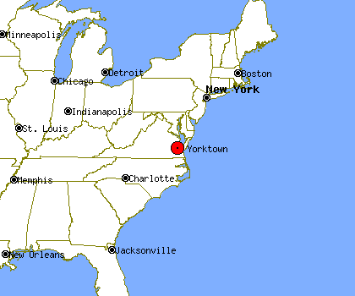
Yorktown
Patriots won the war
Why?
1. British underestimated the Patriots
2. British misunderstood the political nature of the conflict
3. Patriots were highly motivated and G. Washington was a shrewd leader
4. Patriots received critical assistance from France
Summer 1781 Washington heads south
With the help of the French Navy, he trapped Cornwallis and the British troops at Yorktown, VA
Cornwallis surrendered Oct. 19,1781

Slide 6
Treaty of Paris 1783
Great Britain and Americans signed a treaty
Recognized independence from Britain
Gained land for the colonists
Removed British soldiers from Americas
Encouraged Americas to pay Loyalists for property damage
Secured fishing rights off the coast of Newfoundland
Americans strained their relationship with the French

Slide 7
Changes in the Americas
Women's Rights:
Gained few new rights
Gained respect for their support during the war
African Americans:
Most that had escaped slavery were re-enslaved
Most remained enslaved
Americans were criticized for fighting a war for freedom but enslaved men.
Native Americans:
Were pushed off lands toward the west for allying with British

Slide 8
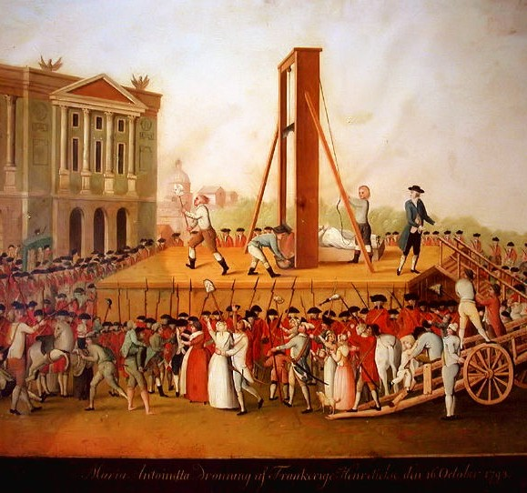
The French Revolution
“All men are created equal” a radical idea
Inspired the French Revolution in 1789
Marie Antoinette and Louis XVI in 1793

