Slide 1
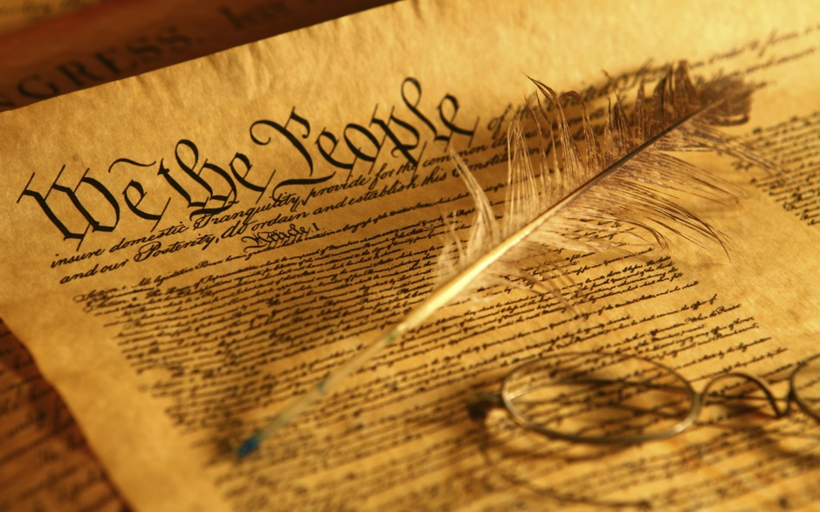
Unit 3, Chapter 5, Sec. 1
A Confederation of States

Slide 2
Background—Roots of Government
Magna Carta (1215) was the first document forced onto a King of England by a group of his subjects in an attempt to limit his powers by law and protect their privileges
  The King was no longer able to tax without the permission of nobles
    a. This group of nobles evolved into a governing body called Parliament
        Parliament became a bicameral government
          House of Lords- Nobles who inherited their seat
          House of Commons- Members elected by commoners

Slide 3
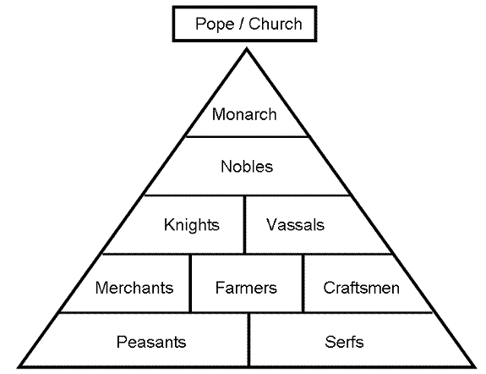
Hierarchy Feudal Government

Slide 4
English Bill of Rights 1689
King James II tried to rule without Parliament
  Revoked colonial charters & replaced colonial elected assemblies with crown appointed governors and councils
  Was overthrown during Glorious Revolution
Replaced with King William and Queen Mary
  Agreed to rule with Parliament and sign Bill of Rights
  -Bill of Rights guaranteed many freedoms including Habeas Corpus—a judicial mandate requiring that a prisoner be brought before the court to determine whether the government has the right to continue detaining him

Slide 5
English Bill of Rights cont.
    The English Bill of Rights 1689 laid out certain basic rights for (at the time) all Englishmen:
  no royal interference with the law
  no taxation by royal prerogative (agreement of the Parliament became necessary for the implementation of any new taxes)
  freedom to petition the monarch without fear of retribution
  no standing army may be maintained during a time of peace without the consent of parliament
  no royal interference in the freedom of the people to have arms for their own defense
  no royal interference in the election of members of Parliament
  the freedom of speech and debates or proceedings in Parliament ought not to be impeached or questioned in any court or place outside of Parliament
  "grants and promises of fines or forfeitures" before conviction are void
  no excessive bail or "cruel and unusual" punishments may be imposed

Slide 6
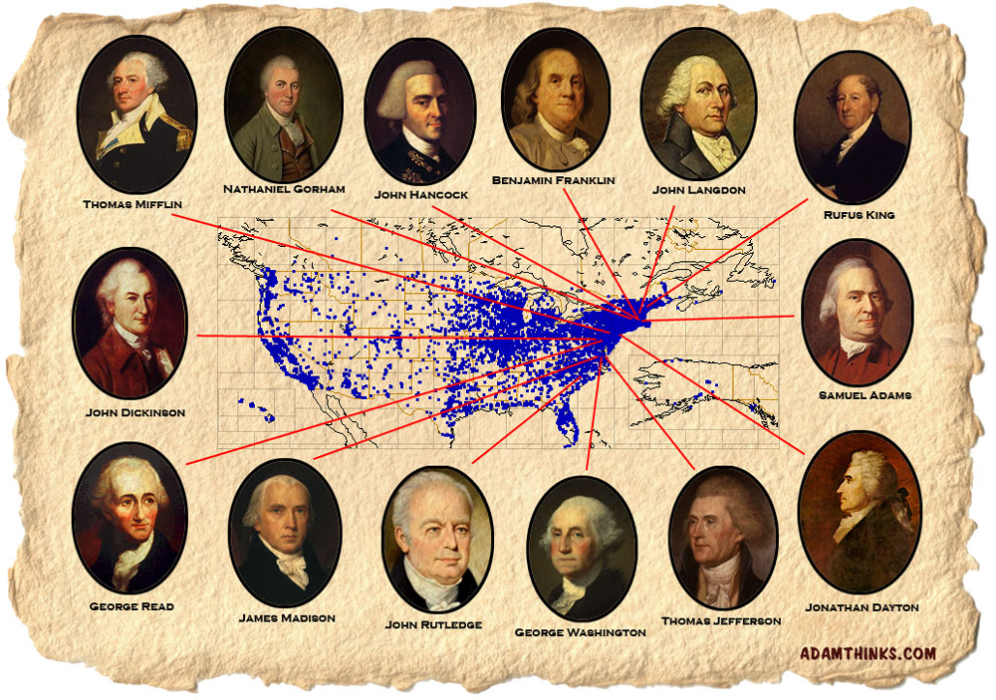
Two Big Responsibilities
Once they had independence, the Americans had to keep it. They had to constantly keep an eye on the British
They also had to create their own government

Slide 7
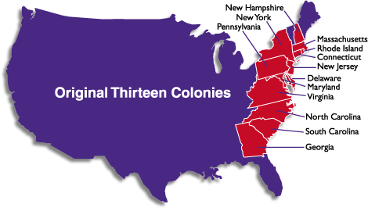
13 Separate Governments
The new Americans were fearful of a single ruler or one group having too much power, so…
Most authority remained with the states

Slide 8

13 Separate Governments cont.
1776 the Continental Congress asked each state to draft its own constitution
Although constitutions varied, ALL were REPUBLICS—the people elected their representatives

Slide 9
POWER—most states chose bicameral legislatures, but
Some state constitutions limited the power of the governor or no governor at all
  This made the Legislature very powerful
  Preferred a unicameral legislature—one house elected by constituents
  Georgia and Pennsylvania
Elections were held frequently
  White male that were 21 could vote
  Voters had to own property
  Some free African Americans could vote
  Women could NOT vote

Slide 10
Forming a United Republic of 13 States
Continental Congress gathered to design a plan for a new government in 1776
  The Americans needed a central government to fight against Britain
The Articles of Confederation was adopted 1777
  Lead by John Dickinson of Pennsylvania
  Reflected Declaration of Independence and rejected a strong centralized Government

Slide 11
Articles of Confederation
Powers and Limitations
  Could:
  Conduct foreign affairs
  Maintain armed forces
  Borrow money
  Issue currency
Could not:
  Regulate trade
  Force citizens to join the army
  Impose taxes
*If congress needed money or troops they had to ask the states but the states did not have to give them anything

Slide 12
Under the Articles
There was no president
Only a Congress with delegates selected by state legislatures not voters
Each state had one vote
Changing the Articles:
  To pass a law at least 9 states had to vote “yes” for the suggested law.
  To change the articles all 13 states had to vote “yes” for the change.

Slide 13
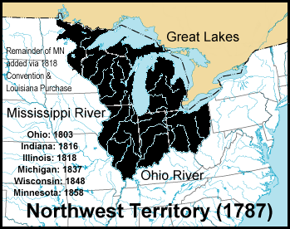
Land Ordinances
Northwest Territory
  Land north of the Ohio River and west of Pennsylvania to the Mississippi River

Slide 14
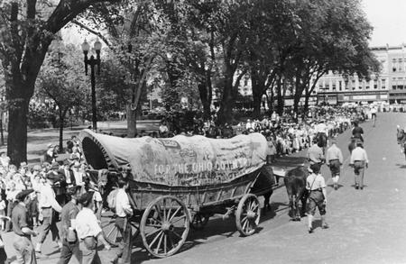
Unregulated Settlement
By 1784, hundreds of settlers had already moved west of the Ohio River
  Provoked war with the Native Americans
    Feds couldn’t afford to fund war with the Natives
    Fear the territories would secede
        Form their own states and
        Turn to the British or Spanish for support

Slide 15
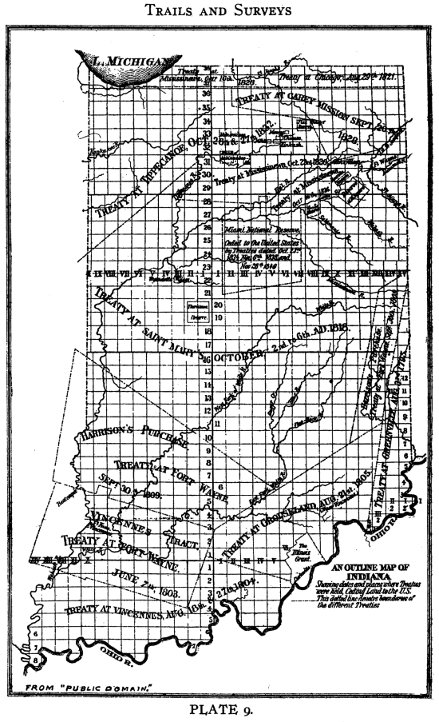
Land Ordinance of 1785
Managing the Northwest Territory
  1 mile grid, north to south and east to west
  Townships each 6 square miles
  Townships subdivided into 36 “sections” of 1 square mile each (640 acres)
  Sections sold for $1/acre or $640

Slide 16
New Land Policies
The Articles did not have provisions on how to add a new state
Northwest Ordinance of 1787
  Established a territorial government w/governor
  When the districts had a high enough population (60,000 people) they could petition for statehood
  Barred slavery from the territory
  Ohio, Indiana, Illinois, Michigan, Wisconsin, and Minnesota entered the Union as free states
  Provided many freedoms for settlers, but ultimately at the expense of Native American peoples

Slide 17
Government Problems
Financial Trouble
International Trouble

Slide 18
Economic Despair
After the War the Country had a large debt
  Congress could not tax to pay the debt
Paper money
  Was not backed by silver or gold which made it worthless
  The price of food and other goods skyrocketed
  Food riots broke out

Slide 19
Economic Depression
Plantations were damaged during the war
  Rice sales dropped
Trade was slow because the British closed off trade with West Indies
Farmers could not pay taxes so their lands were seized by state officials

Slide 20
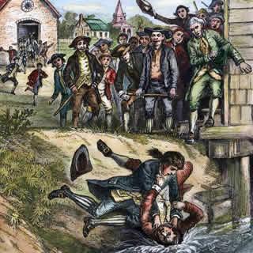
Debt → Rebellion
Farmers were in debt because they could not sell goods or pay taxes.
State officials seized their land to pay taxes
Daniel Shays led farmers in rebellion to shut down courts
No court, no land seizure

Slide 21
Shay’s Rebellion 1787
Daniel Shays led 1000 farmers toward federal arsenal for weapons
State militia was called out
4 farmers were killed
Rebellion ended
People feared more rebellions would happen

Slide 22


Foreign Diplomacy--NO
R-E-S-P-E-C-T
Even though the Americans won the Revolution, Spain and Great Britain did not respect their independence.
They thought the
new American
government was weak
and ineffective

Slide 23
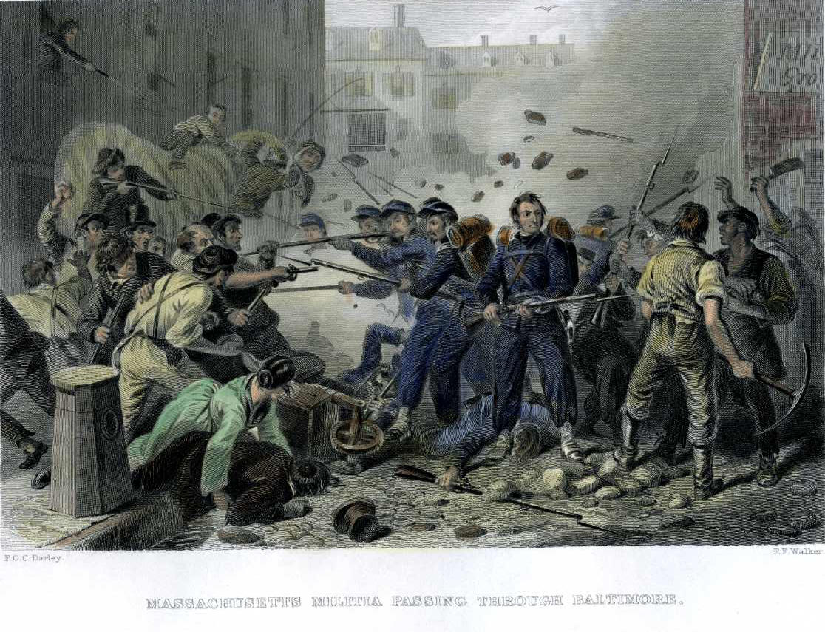
Foreign Diplomacy cont.
“During the mid-1780s, the Spanish and British did not take the new United States seriously. To them, the republican Confederation seemed weak to the point of anarchy or lawlessness.” (pg. 139)

Slide 24
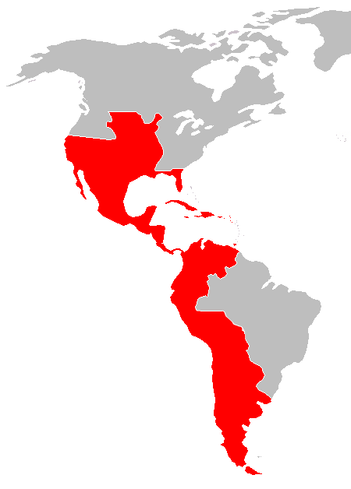
Foreign Diplomacy cont.
Problems with Spain
Land that Spain was granted Treaty of Paris 1783
Forbade trade with New Orleans (Louisiana Territory)
Spain closed the Mississippi River to the Americans to prevent them from expanding further west (1784)

Slide 25
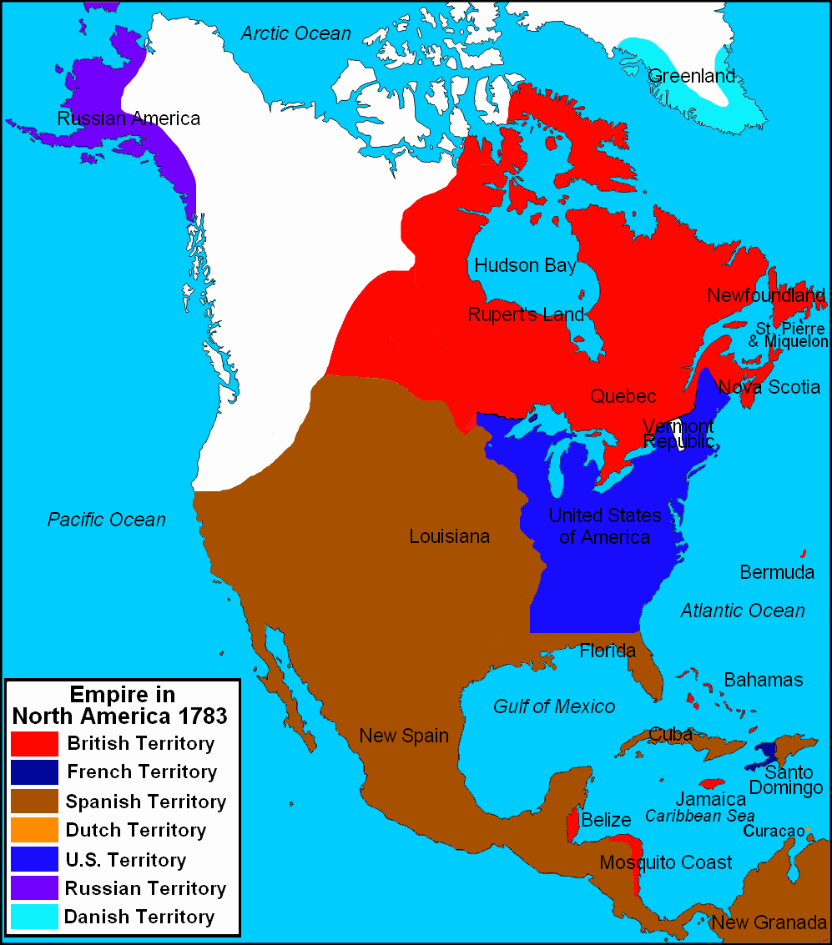
Foreign diplomacy cont.
Problems with Great Britain
  British Territory (red)
  Post Revolutionary War

Slide 26
American vs. British
Treaty of Paris
After the war was over the Americans still had to battle the British
  The British ignored the Treaty of Paris and kept their troops in American Territories
  The British wouldn’t allow Americans to trade in West Indies
  The British refused to negotiate because the Americans had not paid loyalists for the property they lost during the war.

Slide 27
Issue of Slavery
Some People worked to end slavery
  Between 1776-1786 all states except South Carolina and Georgia outlawed or taxed the importation of Slavery
In 1774 Quakers in Pennsylvania set up the first American antislavery society
Pennsylvania passed a gradual end to slavery law in 1780.

Slide 28
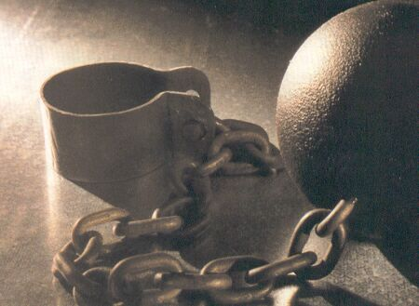
Massachusetts ruled slavery illegal in 1783
NY, NH, RI, CT, & NJ abolished slavery between 1783 and 1804.
Free African American’s still faced harsh discrimination and segregation
Free African Society Formed in Philadelphia (1787)

Slide 29
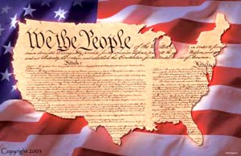
A Call for Change
The Articles of Confederation were weak and unable to deal with the needs of the nation
Many people called for change
  Some wanted to fix the Articles of Confederation
  Others wanted a stronger new government
      https://www.youtube.com/watch?v=bO7FQsCcbD8 Crash Course History—The Constitution, the Articles and Federalism

Slide 30
Assessment
Comprehension
For each item listed below, write a sentence explaining his/its significance to the formation of a new national government.
    John Dickinson
      John Dickinson, a delegate to the Continental Congress from Pennsylvania, authored the 1st draft of the Articles of Confederation.
    Northwest Territory
    Land Ordinance of 1785
    Northwest Ordinance of 1787
    Shay’s Rebellion

Slide 31
Assessment cont.
Vocabulary
  Land Ordinance
    The Land Ordinance of 1785 designed a system for distributing public lands.
    The Land Ordinance of 1787 provided a system of government for the western territories.
  Articles of Confederation
    The Articles of Confederation was the first constitution for the union of the 13 original states.
  Republic
    A republic is a form of government in which officials are elected by the people

Slide 32
Assessment cont.
Vocabulary cont.
  Bicameral
    A bicameral legislature is a lawmaking organization with two houses.
        Example: British Parliament with the House of Lords and the House of Commons
        Or the U.S. Congress with a Senate and House of Representatives
  Shay’s Rebellion
    Shay’s Rebellion was a revolt that occurred in Massachusetts in 1786. Farmers took up arms to shut down the courts and block property foreclosures.

Slide 33
Assessment cont.
Describe the form of national government the Patriots created initially.
  A Congress w/very limited powers
  No President or executive branch
  No federal court system
What events revealed that a new government was necessary?
  Spanish/British trade restrictions
  British forts remained inside U.S. territory
  Failed attempts to amend the Articles
  Weakening U.S. economy
  Shay’s Rebellion

