Slide 1
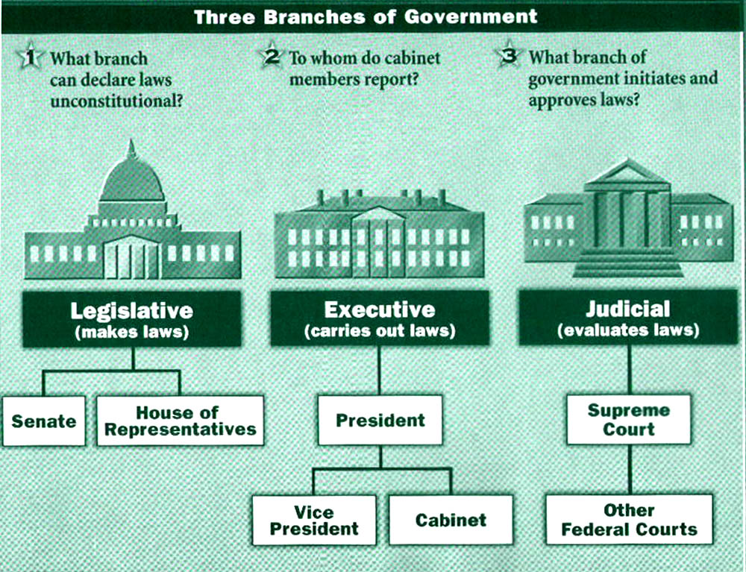
Ratifying the Constitution Constitutional Framework
A. Executive Branch
B. Legislative Branch
C. Judicial Branch

Slide 2
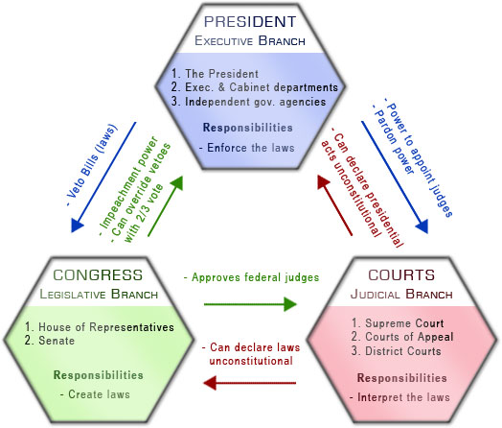
Separation of Power
a. Checks and balances

Slide 3
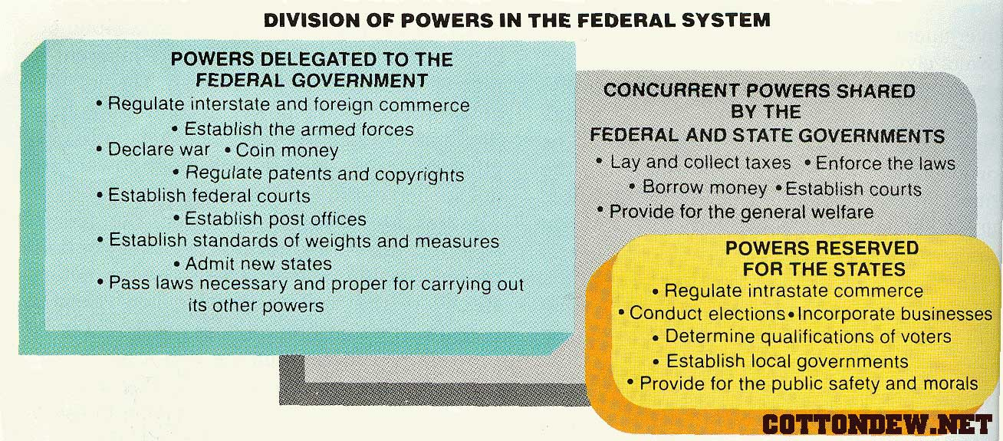
Separation of Power cont.

Slide 4
Constitutional Debate
A. Federalists—favored ratification of the new Constitution
Favored a strong central government
Included: George Washington, James Madison and Alexander Hamilton
Feared the United States would come apart if a stronger central government wasn’t in place
The Federalist Papers—a series of 85 essays Published in NY, Madison, Hamilton, J. Jay

Slide 5
Thinking Critically
Read James Madison: The Federalist, #10, pg. 157
According to Madison, what are the differences between a democracy and a republic? Which does he support and why?
In a democracy the people rule; in a republic the people choose a small group of citizens to govern fro them; Madison supported a republic because it is better suited to a large population and a large country

Slide 6
Thinking Critically cont.
Does Madison consider factions to be good or bad for the nation?
Madison thinks factions can be dangerous if they are not checked or if one such group takes control.

Slide 7
Constitutional Debate cont.
B. Antifederalists—preferred to amend the Articles of Confederation
Favored state sovereignty
Included: Sam Adams, John Hancock and Patrick Henry
Feared the loss of freedom and potential tyranny

Slide 8
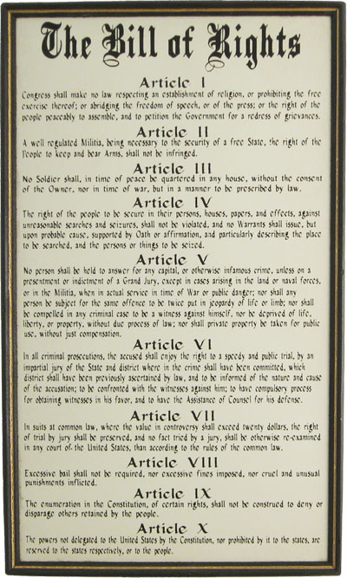
The American Bill of Rights
Freedom of religion, speech, press, assembly
The right to bear arms
Prohibits quartering of troops in private homes
Protects from unreasonable search & seizure
Provides due process for accused persons
Provides the right to a speedy and public trial
Guarantees the right to a trial by jury of peers
Prohibits excessive bail, cruel & unusual punishment
Provides that people have rights beyond these
Powers not granted to the Feds belong to States

Slide 9
Adopting the Constitution
The Constitution became the supreme law of the land in March 1789
To this day, it endures. Why?
Purposely flexible
Provides a process for its own amendment
Amendment is possible, but difficult
2/3 of BOTH house of Congress must approve
3/4 of states must ratify
The Bill of Rights was added December 15, 1791

