Slide 1
Unit 3, Chapter 6 The New Republic
1789-1816

Slide 2
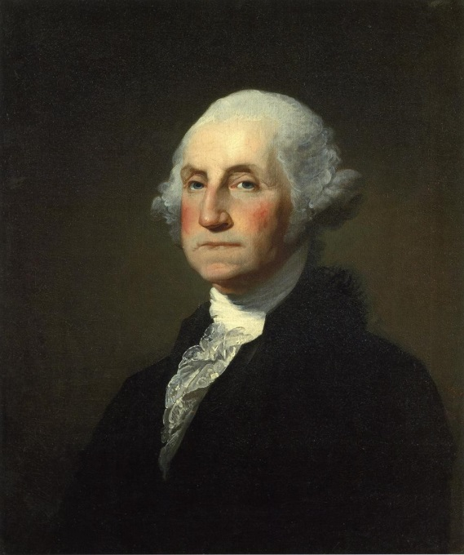
Government and Party Politics
Washington’s Presidency

Slide 3
Background Information
George Washington was the first President of the United States (1789–1797)
the Commander-in-chief of the Continental Army during the American Revolutionary War and
One of the Founding Fathers of the United States
He presided over the convention that drafted the Constitution which
replaced the Articles of Confederation and
established the position of President

Slide 4
Background cont. (pgs. 192-193)
Washington was elected President in 1788
the unanimous choice of the electors
He was well-respected and popular
He accepted the job reluctantly—Primary source “About 10 o’clock I bade farewell to Mount Vernon, to private life, and to domestic felicity (happiness), and with a mind oppressed with more anxious and painful sensations than I have words to express, set out for New York.” April 16, 1789
he served two terms in office
oversaw the creation of a strong, well-financed national government that
maintained neutrality in the wars raging in Europe
suppressed rebellion, and
won acceptance among Americans of all types

Slide 5
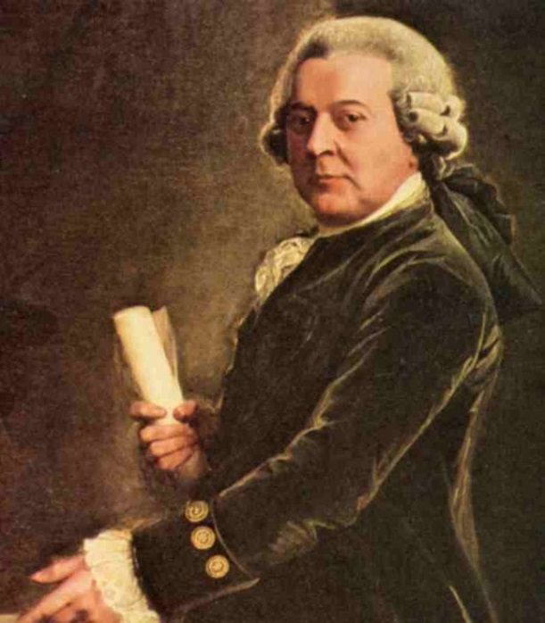
Background cont.
John Adams was elected Vice President
Washington’s administration (the officials in the executive branch) included Washington, Adams and about 12 clerks
Quickly after taking office, Washington began to set important precedents (acts or statements that became traditions to be followed)

Slide 6
Precedents
Washington knew that he had been given the power to shape the American Presidency. With no prior model to follow, the responsibility of setting precedents was his. His leadership style established many forms and rituals of government that have been used since, such as:
using a cabinet system and proposing legislation to Congress
delivering an inaugural address
Recommending the official title, “Mr. President”
Setting aside late afternoons for meetings with the public and evenings for dinner parties for friends and invited guests
Retiring after two terms
the peaceful transition from his presidency to the presidency of John Adams established a tradition that continues into the 21st century
Washington was hailed as “father of his country" even during his lifetime

Slide 7
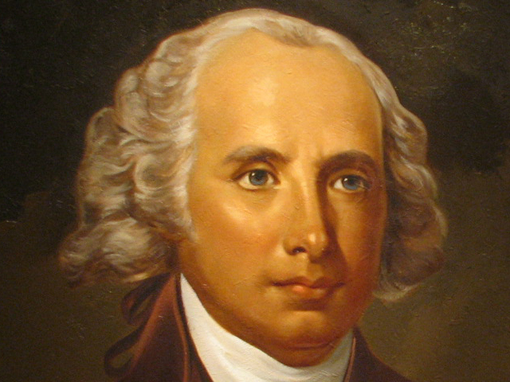
Government Organization
Organizing the Federal Court System
The Constitution required the establishment of a Supreme Court, but
left the details of organizing the court system to Congress
James Madison was elected to the 1st Congressional House of Representatives
He helped pass the Judiciary Act of 1789
Established a Judiciary (system of courts)

Slide 8
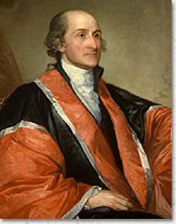
Government Organization
The Judiciary Act of 1789
13 federal district courts—1 for each state
3 circuit courts to hear appeals from state courts
6 member Supreme Court
John Jay was appointed 1st Chief Justice
Decided contested cases
Served as trial court in certain cases involving states or foreign affairs
Established the office of Attorney General (Federal Prosecutor)

Slide 9
Government Organization cont.
Setting up the Cabinet (A group of federal leaders who headed the major departments of the executive branch and advised the President)
Cabinet members were nominated by the President and approved by the Senate
State Department—Thomas Jefferson, Secretary of State, conducted foreign policy (Antifederalist)
Treasury Department—Alexander Hamilton, secretary of the Treasury, managed federal finances (Federalist)
War Department—Henry Know, Secretary of War, supervised national defense
Attorney General—Edmund Randolph
How many cabinet members today?
15—The Cabinet includes the Vice President and the heads of 15 executive departments — the Secretaries of Agriculture, Commerce, Defense, Education, Energy, Health and Human Services, Homeland Security, Housing and Urban Development, Interior, Labor, State, Transportation, Treasury, and Veterans Affairs, as well as the Attorney General http://www.whitehouse.gov/administration/cabinet

Slide 10
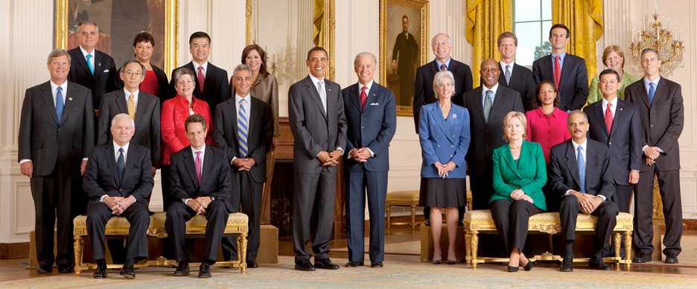
Checking Your Understanding
Why was setting up the Cabinet an important precedent?
Setting up the Cabinet was an important precedent because the Cabinet members provided leadership for the various parts of the executive branch and helped advise the President
Setting up a Cabinet didn’t become law until 1907

Slide 11
$Financial Crisis$
The United States was severely in debt as a result of the Revolutionary War
Owed money to foreign nations and
American Citizens
**Alexander Hamilton was Secretary of the
Treasury**

Slide 12
Financial Crisis
Hamilton’s plan (Federalist)
Felt nation’s agricultural economy was backward
Wanted to develop a commercial and industrial economy
Support a large federal government
Strong Army and Navy
Saw the national debt ($52 million) and additional states’ debt ($25 million) as ASSETS
Rather than paying debt down, he proposed to fund them by selling government bonds
bonds paid annual interest (dividends) to the holders
To fund the annual interest on the bonds, Hamilton proposed
New excise taxes-- taxes paid when purchases are made on a specific goods, such as gasoline or whiskey
New tariffs on imports
Creation of a National Bank
So- o-o-o why did Hamilton want to add to the national debt?
Hamilton wanted to stabilize the economy first, which required increasing the debt to pay off earlier debt and give the nation financial stability.

Slide 13
Taxes and Tariffs
Hamilton proposed Tariffs on imported goods to try to get American’s to buy only American goods
Revenues from tariffs made up 90% of National Income in 1790
Hamilton created national taxes to raise money for Government

Slide 14
Hamilton’s Plan cont.
Hamilton saw 3 benefits to his plan:
It would establish the Nation’s financial credibility making it easier to borrow money in the future
It would buy political support from America’s wealthiest citizens
It would enrich investors so that they could/would invest in the commercial and industrial infrastructure by building ships and storehouses and dock and factories, etc.
His plan was to redistribute wealth in 2 ways:
From farmers to merchants
From South to North
Most of the debt was owed by seaport cities of the Northeast
Southern states did a better job of paying-off their debts

Slide 15
The Bank
Hamilton proposed a national bank
The Bank of The United States
T. Jefferson & J. Madison Opposed the bank saying it would only benefit the wealthy
Also claimed it was Unconstitutional
Washington agreed with Hamilton and passed the bill

Slide 16
Controversy to Come
Hamilton experienced opposition to his policies and to the financial power he gave the federal government
Congress split down the middle regarding the issue
T. Jefferson & J. Madison had different visions than A. Hamilton of what the USA should become.

Slide 17
Opposition
To justify his ambitious plan, Hamilton interpreted the Constitution rather broadly
Relied on “implied powers” empowering Congress to enact laws for the “general welfare” of the country.
This broad interpretation, or loose construction (Hamilton’s), of the Constitution appalled opponents
Opponents (Jefferson and Madison) preferred a more literal interpretation, or strict construction, of the Constitution limiting federal power
Jefferson and Madison accused Hamilton of establishing a “kingly government

Slide 18
Compromise
Congress agreed to pay off debts to foreign countries, but,
They did not want to pay American Citizens that bought war bonds
Speculators were thought to get too wealthy from this plan
Original bond owners felt cheated. And,
southern states thought they would be paying more than necessary since their war debt wasn’t as large as the North’s
Why, asked Southern voters, should they have to pay federal taxes to bailout Northern debts?

Slide 19
Compromise
Southern states agreed to pay if the Nation’s Capital was located in the South
Washington D.C. was created due to this compromise

Slide 20
Checking Your Understanding
Why did Hamilton want to add to the national debt?
He wanted the federal government to take over those debts. He wanted to stabilize the economy first, which required increasing the debt to pay off earlier debt and give the nation financial credibility

Slide 21
Assignment:
Read page 195, The Whiskey Rebellion
Analyze the Political cartoon by answering:
Which figure(s) in the cartoon represent(s) the rebel(s) and which the government? Does the cartoonist side with the government or the rebels? How do you know?

Slide 22
Whiskey Rebellion
Hamilton’s taxes angered people in western Pennsylvania (think British taxes)
It was difficult to transport grain from w. Penn., across the mountains, to eastern markets, so they distilled their grains into spirits (whiskey) to take to market
And, farmers often bartered and traded, so they did not have cash-money for taxes, so
In 1794 they rebelled burning buildings and attacking tax collectors

Slide 23
Whiskey Rebellion cont.
President Washington crushed the rebellion by sending in troops
He said if citizens wanted the laws changed they had to do it peacefully
The Government would use force when necessary

Slide 24
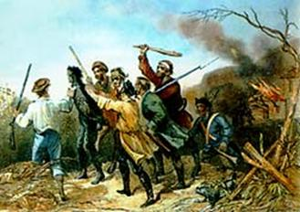
Whiskey Rebellion cont.
At the recommendation of Hamilton, as Commander In Chief, Washington sent in 12,000 troops to end the rebellion
Farmers recognized they were out-numbered, so many just stayed home
Rebellion dissolved
Country divided

Slide 25
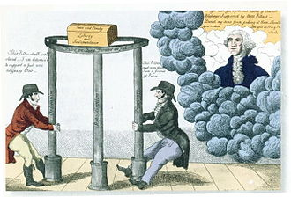
Emergence of Political Parties

Slide 26
Election of 1796
By 1796 Americans began to divide into opposing groups and form political parties
Parties began as social clubs called “Democratic Societies”
Washington denounced political parties
“they will divide the nation”
Many Americans considered political parties harmful
“factions” were to be avoided as much as strong central government

Slide 27
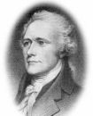
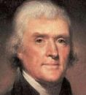
The Parties Emerge
Federalist
Hamilton & Adams
Supported the policies of Washington administration
Rule by the wealthy
Loose interpretation of Constitution
Liked strong federal government
Emphasis on manufacturing
National bank
Protective tariffs
Supported Britain
Democratic-Republicans
Jefferson & Madison
Wanted to limit power of federal government
Rule by the people
Strict/literal interpretation of the Constitution
Strong state governments
Emphasis on agriculture
State banks
Free trade
Supported French

