Slide 1
The Struggle Over foreign policy

Slide 2
Frontier Violence Foreign Influence in West
US wanted push the British out
Britain urged Natives to destroy US settlements

Slide 3
Frontier violence Native American Land Disputes
Native American tribes claimed that the US government had no authority over them
Washington worried that the European nations would try to take control of the Northwest Territory
Washington made treaties with Native tribes hoping it would decrease the influence of Britain and France
American Settlers broke the treaties made with the Natives
Washington sent General A. St. Clair to restore order
November 1791 St. Clair’s forces were beaten by Chief Little Turtle
600 soldiers were killed

Slide 4
Battle of Fallen Timbers
Native Americans demanded US settlers leave the territory
Washington sent in General Anthony Wayne
He defeated 1,000 Native warriors at the Battle of Fallen Timbers
Treaty of Greenville (1795) The Natives surrendered most land in present-day Ohio

Slide 5
Foreign Policy
The French Revolution began in 1789
Many Americans sympathized with the French
Others were offended by how bloody the war became
Great Britain went to War with France in 1793
Washington wanted the US to stay neutral

Slide 6
Remaining Neutral
French tried to get the US to take their side in their battle with Britain
Sent Edmond Genet in April 1793 to recruit American Volunteers to attack British ships
April 22, 1793 Washington issued a Proclamation of Neutrality
Prohibited Americans from fighting in the war
Barred French and British ships from American ports

Slide 7
Britain vs. America
The powerful British Navy tested U.S. neutrality
British began attacking American ships and impressing its men into service on their ships.
Impressments made the US mad and pushed them closer to war

Slide 8
Treaty
Washington sent John Jay to Britain to negotiate a treaty
The Jay Treaty 1794
British would pull from American soil
Pay damages for ships seized
Allow some trade with British colonies
Settled debts from before 1776

Slide 9
Reaction
Americans were not happy with Jay’s Treaty
Said it did not address impressments
Did not address trading
Washington didn’t love it but sent it to the Senate for approval
Barely passed in the Senate

Slide 10
Treaty with Spain
Thomas Pinckney was sent to Spain to negotiate differences between US & Spain
Pinckney’s Treaty (1795)
Gave Americans free navigation of the Mississippi River
Right to trade at port of New Orleans

Slide 11
Checking understanding
What treaties were signed during Washington’s presidency?
Treaty of Greenville 1795
Between U.S. and American Native Indians
The Jay Treaty 1794
Between U.S. and Britain
Pinckney's Treaty 1795
Between U.S. and Spain

Slide 12
Washington’s Farewell
September 1796 Washington announced he would not run for a 3rd term
Set the Precedent for future presidents
Warned against:
making permanent alliances with other nations
Forming political parties
“observe good faith and justice toward all nations…Tis our policy to steer clear of permanent alliances.”

Slide 13
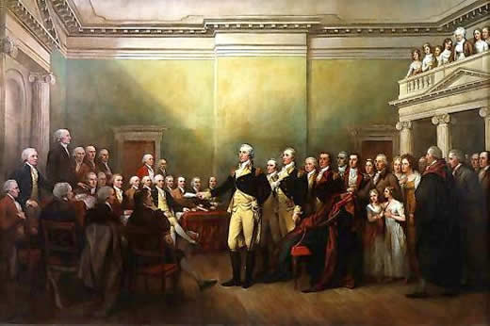
Workbook Assignment
Complete Washington’s Farewell Address Analysis in your workbook (Page 204 in your textbook)

